Slide 1
The EMERALD Study
EMpowering, Enabling Resilience And Living with Dignity:
Evaluating new interventions for females participants in Roseacre Ward Session 2
Professor Shula Ramon
Associate Professor Joanna Fox

Slide 2

What we covered in Session 1
Training session 1
Introduction
What is Photovoice?
What our photos mean to us.
Go into the garden and take photos - 30 mins
Getting into pairs: discussion of the meaning of photos
This Photo by Unknown Author is licensed under CC BY-SA

Slide 3
What we will cover in Session 2
Training session 2
Take some photos of your lunch. Tell us what you like / like less about the lunch
Jo and Shula to share their photos
Which photos to take and not take
How photos will be used in the study
  Getting permission to take photos
  Sending photos to the researchers
Role play – using the photos in your interview
This Photo by Unknown Author is licensed under CC BY-SA

Slide 4
Introduction
Our contact details
Shula Ramon
s.ramon@herts.ac.uk
Joanna Fox
Joanna.Fox@aru.ac.uk

Slide 5
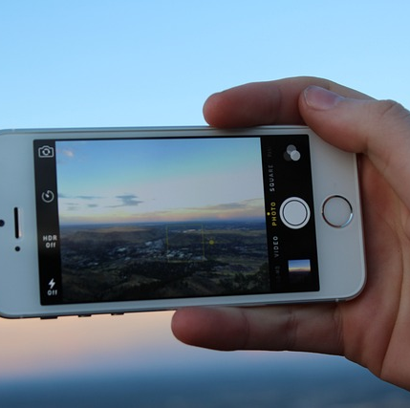
Reminder: What is photovoice?
Sometimes called Photo elicitation
Photovoice has been used in research to enable people to describe their recovery experience, or any meaningful experience.
It comes instead of having to ask and respond to too many questions
A picture can tell a thousand words.

Slide 6

Sharing photos
Take some photos of your lunch
What do you like / like less in the lunch?
Are there reasons for this?
Are you a vegetarian / vegan / meat eater?
What does this choice in the photo tell us about you?

Slide 7
Use of photos by Joannah, Lived Experience Advisory Panel member
https://youtu.be/IfP9I2Ufxl0?si=KOStVoqW16gRgy6D

Slide 8

The photos
How will the photos be used?
All participants’ photos will be stored under a false name (pseudonym) chosen by you.
In interviews to talk about your experiences on the ward
In an optional online photo exhibition.
You need to gain consent if a person is identifiable in the photo.

Slide 9

Which photos to take: The Dos
Pictures of objects
Pictures of things in the garden
Pictures of objects on the ward
People who have gone through the consent process
This Photo by Unknown Author is licensed under CC BY-SA-NC

Slide 10
Which photos not to take
The Don’ts
Don’t take photos of staff
Don’t take pictures of people who can be identified without their formal permission
Don’t take photos of self-harm or intended self-harm
Don’t take pictures of other people in distress
Don’t take pictures of people not able to give consent
Don’t take pictures of people under the age of 18-years-old
This Photo by Unknown Author is licensed under CC BY-SA-NC

Slide 11
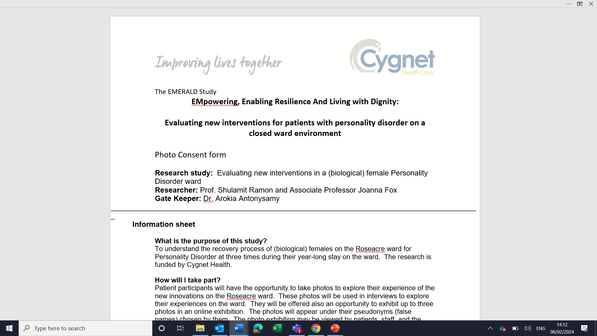
Gaining permission
Fill in the consent form

Slide 12

Why consent is necessary?
Why do you think we need to ask people for their permission to take their photo?
  They own their own image
  They have the right to know how their image is used
  They may not want to appear in a study
  Without consent, their face will be blurred for the purposes of the study.
This Photo by Unknown Author is licensed under CC BY

Slide 13
How to send the photo to us
In the two weeks before the interview
During weekdays and working hours
From a special Cygnet phone

Slide 14
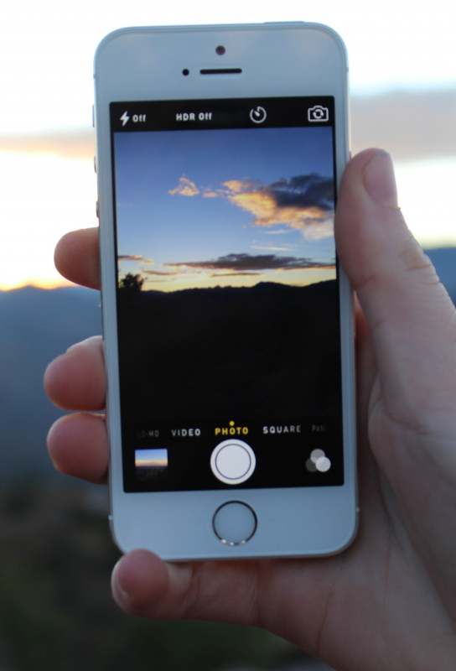
Role play: get into pairs
Share a photo you have taken over the last few days
Please describe the photo to your partner
What does this tell you about your experience on the ward?
What is good / not so good about that experience?
What does this photo tell us about how you are feeling?

Slide 15

Your participation in the Emerald study
Ethical approval has been acquired for this study. The Participant Information Sheet and Consent form have been approved by the Health Ethics Committee and Cygnet Research and Development Committee.
You will be asked to choose a false name (pseudonym) under which all your information will be stored.
Interviews with photos at 3, 7 and 12 months
Using photos to discuss your experiences
Allowing the ward staff to submit information from your notes about your different ward activities
All information will be stored under a false name (pseudonym) chosen by you.
An opportunity – if you would like – to submit your photos to an online exhibition.

Slide 16
Next steps
We hope that you ALL will choose to join the study.
Dr. Ayesha Prout will contact you individually to discuss with you your decision about joining the project.
If yes, she will ask you to sign the consent form.
Ayesha Prout AyeshaProut@cygnethealth.co.uk
  (Ayesha will be available on the ward from 26th February, 2024)
Researchers’ contact details
  Shula Ramon
  s.ramon@herts.ac.uk
  Joanna Fox
  Joanna.Fox@aru.ac.uk

Slide 17
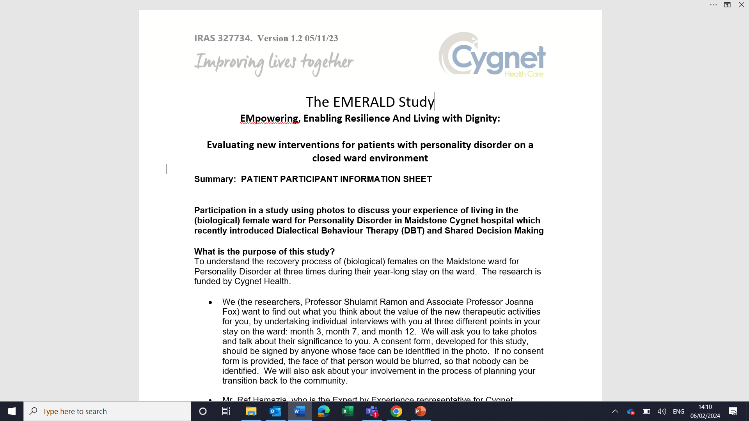
Patient participant information sheet

Slide 18
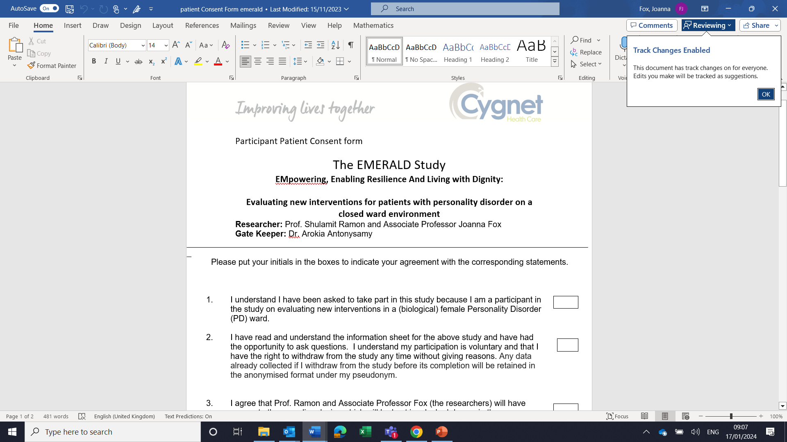
Patient participant consent form

Slide 19
Thank you

