Slide 1
The EMERALD Study
EMpowering, Enabling Resilience And Living with Dignity:
Evaluating the impact of new interventions for females in RoseAcre ward
Session 1
Profesor Shula Ramon
Associate Professor Joanna Fox

Slide 2

Session 1 outline
Training session 1
Self Introduction of all participants
What is Photovoice?
What our photos mean to us.
20 min break
Go into the garden and take photos - 30 mins
Getting into pairs: discussion of the meaning of photos
This Photo by Unknown Author is licensed under CC BY-SA

Slide 3
Introduction
Our contact details
Shula Ramon
s.ramon@herts.ac.uk
Joanna Fox
Joanna.Fox@aru.ac.uk

Slide 4
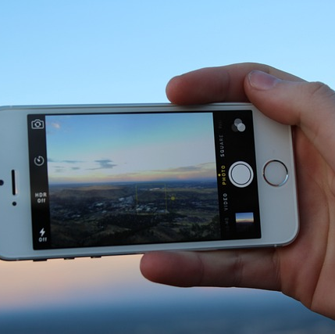
What is photovoice?
Also called Photo elicitation
Photovoice has been used in research to enable people to describe their recovery experience, or any other meaningful experience.
It can provide voice to experience through a photo
A picture can tell a thousand words.
Examples of using this method in recovery research

Slide 5

Milasan (2020) undertook research looking at a photographic exploration of Romanian service users’ experiences of recovery.
This photo showed
A sense of hope and recovery
This Photo by Unknown Author is licensed under CC BY-SA

Slide 6
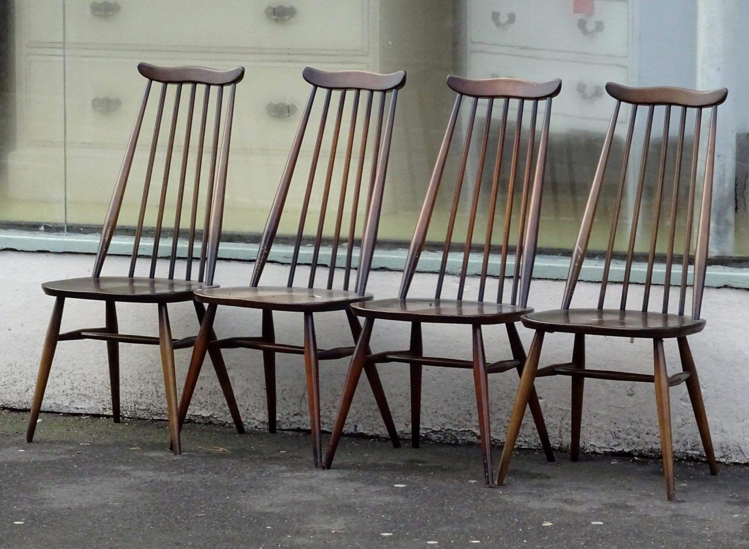
Khalil (2015) explored through photos the role of physical activity in personal recovery.
A photo of chairs showed
A meeting place: waiting at the gym and a chance to talk to people

Slide 7
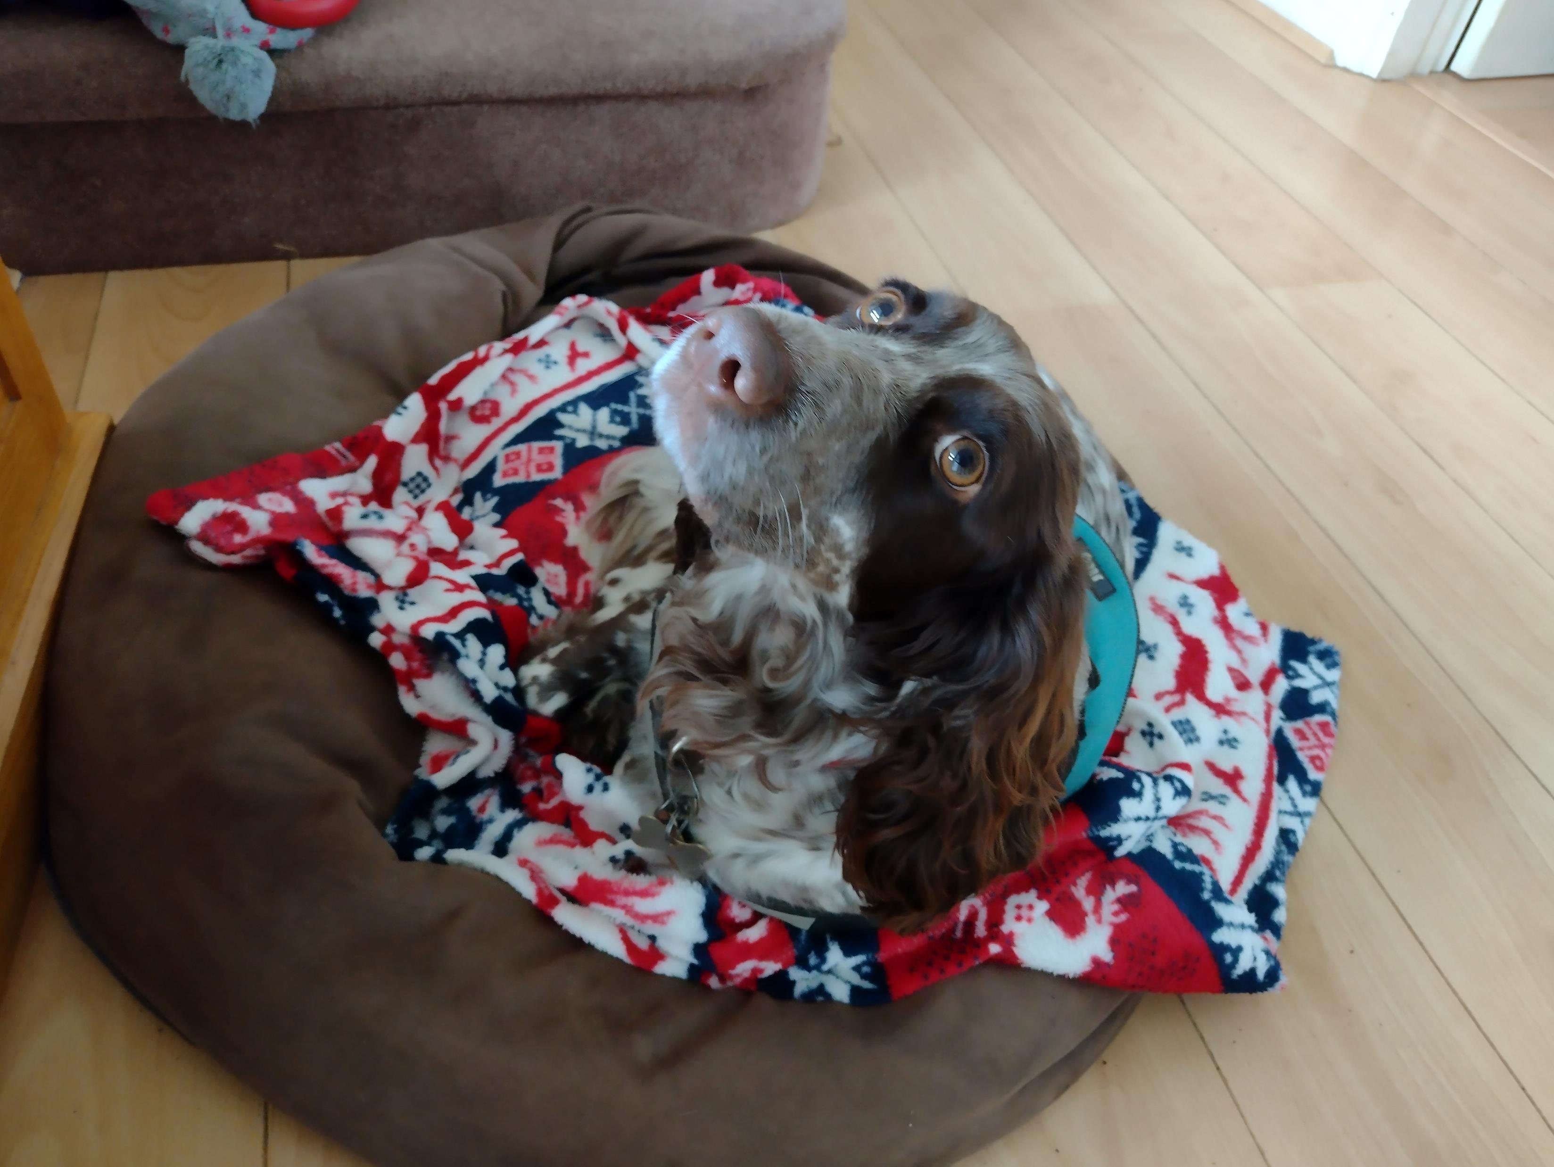
What does this photo mean to Jo?

Slide 8

My dog is part of my recovery
When I am stressed, I take her for a walk
She comes for a cuddle when I am at home alone
She gives me structure to my day when I am working at home
I take her to dog school and scent work training – my hobby!

Slide 9

What does this photo mean to Shula?

Slide 10

What does this photo mean to Shula
Boris and Noam

Slide 11

Breaktime
20 minutes break
This Photo by Unknown Author is licensed under CC BY-SA

Slide 12

TASK: 30 minutes
Go into the garden and take some photos.
Please take photos of objects rather than people.
We will spend some time in session 2 considering which photos to take / not to take
Consider what the picture tells us about your experience on the ward.
This Photo by Unknown Author is licensed under CC BY-NC-ND

Slide 13

Get into pairs and discuss the photo
Please describe the photo to your partner.
What does this photo show about how you are feeling?
Does it allow you to think about your experience on the ward?
Does it represent a positive feeling or a less positive feeling?

Slide 14
The study approvals
Ethical approval has been acquired for this study from the Health Ethics Committee and reviewed by Cygnet Research and Development Committee.
The Participant Information Sheet and Consent form have been approved by these two bodies.
Forms have been reviewed by the Experts-by experience involved in our LEAP (Lived Experience Advisory Panel) and staff at Cygnet

Slide 15
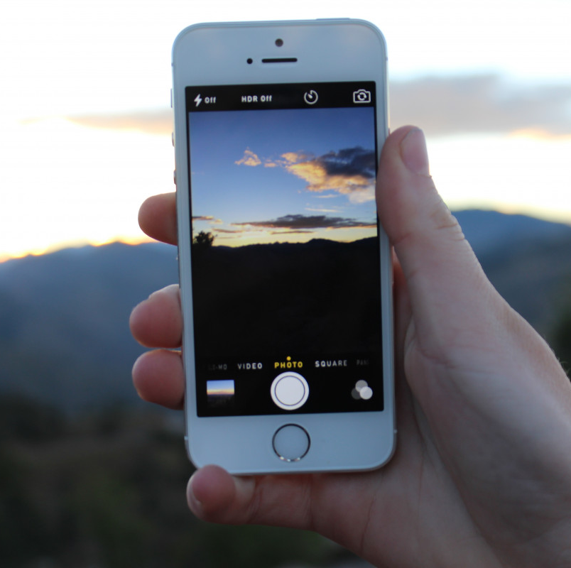
Summary
What is photovoice?
How do I take photos that tell a little bit about my experience.
What do these photos mean to me.
Please look over the Patient Participant Information Sheet and Patient Participant Consent Form and see if you have any questions which you can raise in our next session.

Slide 16
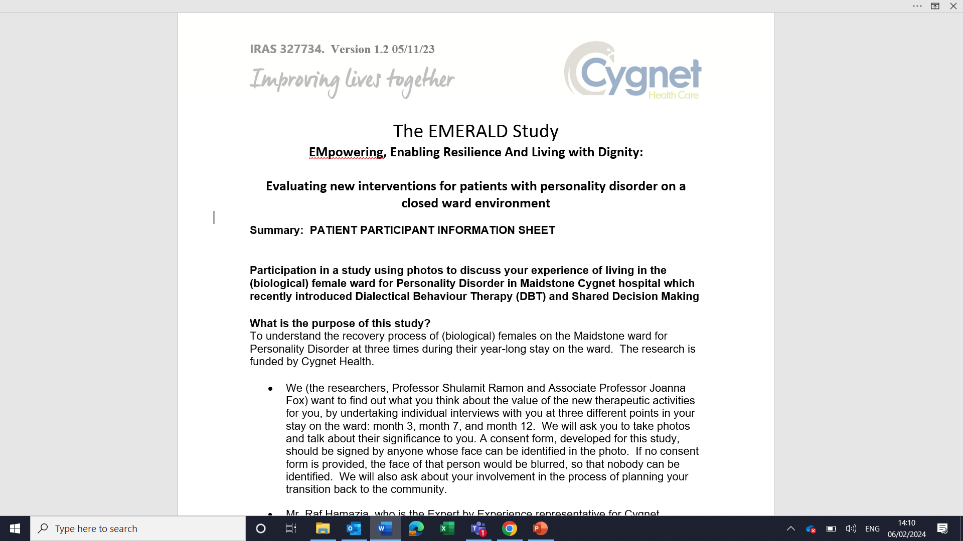
Patient participant information sheet

Slide 17
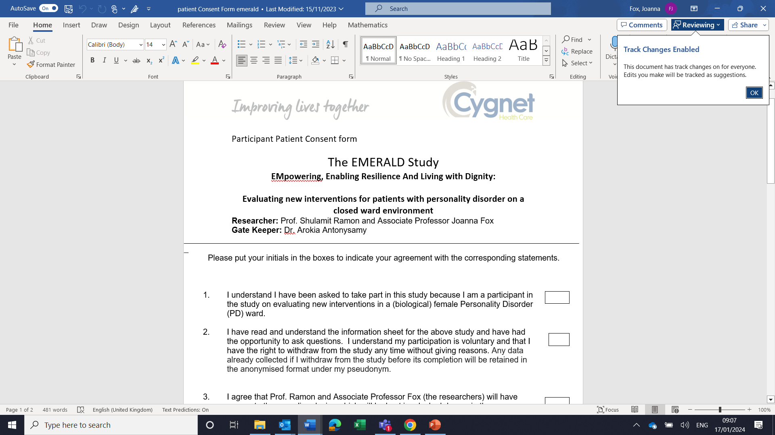
Patient participant consent form

Slide 18
Next steps
You will be given the Patient information sheet and the consent form to read.
Please take time to look at them before next week and please raise any questions you may have with us at the next training session, next week.
Researchers’ contact details
  Shula Ramon
  s.ramon@herts.ac.uk
  Joanna Fox
  Joanna.Fox@aru.ac.uk
  Cygnet contact
  Ayesha Prout AyeshaProut@cygnethealth.co.uk
  (Ayesha will be available on the ward from 26th February, 2024)

Slide 19
Thank you

