Slide 1

De-institutionalisation from Within:
The Emerald Project
Cygnet 17 September 2025
Professor Shula Ramon
(University of Hertfordshire) s.ramon@herts.ac.uk
Assoc Prof Joanna Fox (ARU)
Joanna.Fox@aru.ac.uk
Raf Hamaizia (Cygnet) rafhamaizia@cygnethealth.co.uk

Slide 2
Beyond De-instutionalisation
The UK de-institutionalised its large psychiatric hospitals at the end of the 20th century.
However, women diagnosed as having Borderline Personality Disorder (BPD) are often hospitalised following a compulsory order, due to the high level of self-harm which they experience.
Although most of them have a good intelligence level, they see themselves as a failure, have few friends, complex family relationships, ongoing problems manifested by the end of their adolescence.
Yet we do have an unusual success story in the biography of Prof. Marsha Linehan, who was hospitalised, age 16-18, in a US psychiatric hospital with a BPD diagnosis. She developed later the successful Dialectical Behavioural Therapy (DBT) programme, which offers compassion and acceptance alongside encouragement to become self-responsible for this group of mainly women.

Slide 3
Evaluating Service innovations in a closed ward
Our Cygnet project provided an evaluation focused on service innovation in a closed ward for women diagnosed with Personality Disorder (PD) or Borderline Personality Disorder (BPD)
This group consists mainly of young women, with poor self-esteem, have a history of failed relationships within their family of origin and outside the family, and a high record of self-harm.
As already mentioned, it is the issue of self-harm which leads to the hospitalisation via a compulsory order.
The hospitalisation is aimed to reduce both the seriousness of the self harm as well as its frequency, and to prepare the women for an improved life outside the hospital, often via supported housing or returning to their family or origin.

Slide 4
The Innovations evaluated
Learning from Springbank, a closed ward for the same population in Cambridge, where in 2016 the regime changed into introducing Dialectical Behavioural Therapy (DBT) through individual and group work in 2016
Applying Shared Decision Making in any intervention necessary, including medication;
Enabling the women to go out when they wish to, provided that they stated where they were going, when they would return, and keeping to come back as planned;
Having weekly community meetings;
Creating an informal welcoming culture in the relationships between staff and patients;
By 2019 there was no need to use any isolation or major tranquilisation; and the women came back when they stated that they would do so.

Slide 5
The Cygnet Ward: the Daffodils
The professionals of this closed ward, in a hospital managed by CygnetHealth, learned about this innovative way of working at a public meeting aimed at creating a co-production network between providers and service users led by the director of CygnetHealth.
They then went to visit Springbank and decided to attempt to introduce it to their closed ward of women diagnosed with PD and BPD.
The one difference was that while Springbank revoked the compulsory order upon entering the ward, Daffodils did not do so; such orders were usually revoked about 3 months later.
Staff members included nurses, psychiatrists, social workers, and peer support workers.
Experts by Experience (EbEs) were introduced too and they visit wards every two weeks.

Slide 6
Methods of Evaluation
We wished to apply methods that would enable active participation of the women patients, as well as having in parallel reports by service providers of the different activities the ward offered.
The activities included traditional interventions (e.g. medication), and new ones including DBT, SDM, cooking, occupational therapy, visits outside the hospital in small groups to community facilities, being able to visit one’s family and have them coming to visit the women on the ward, a long process of preparing the next phase of life outside the hospital.
We therefore introduced Photovoice followed by individual interviews with the women, 3 times over one year.
And in parallel we asked for reports from each provider to be submitted at the same time as the interviews with the women.

Slide 7
What is Photovoice; Training to use it
Each woman was asked to prepare a small number of photos which reflect where she was at the time, and the changes she has experienced since coming to the ward
The photos were to be sent to the interviewer in advance of the interview via e-mail
Women were trained to apply the necessary ethical guidelines in taking the photos (e.g choosing a pseudonym, consent),
As well as why we were asking them to do so
The training was offered in two face-to-face meetings with the women, and several staff members were present too
In parallel we had an online training session for staff members

Slide 8
The interviews
The interviews focused initially on the meaning and significance of the photos chosen by each woman;
We asked women what has changed in their lives since coming to the ward
We also asked them what are the changes they wish to achieve prior to leaving the ward, and how they plan to do so
We also asked about their participation in the ward’s activities
As well as about their informal relationships with other women on the ward and their own families.
Interviews were audio recorded.

Slide 9

Experts by Experience
Emerald research project

Slide 10

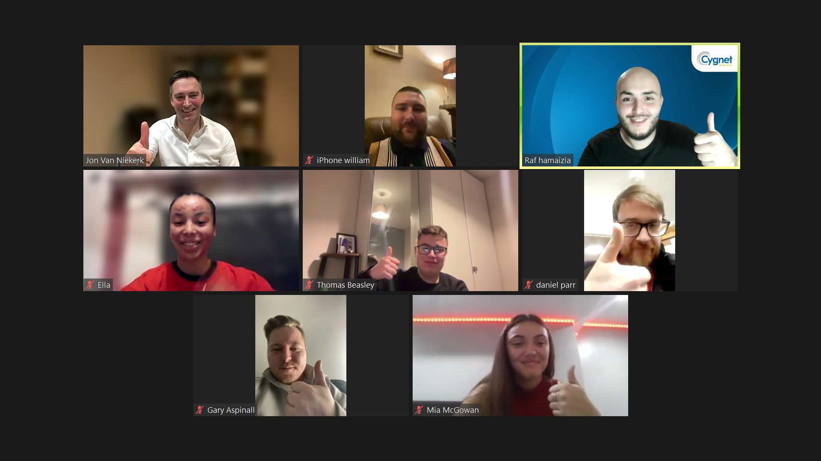
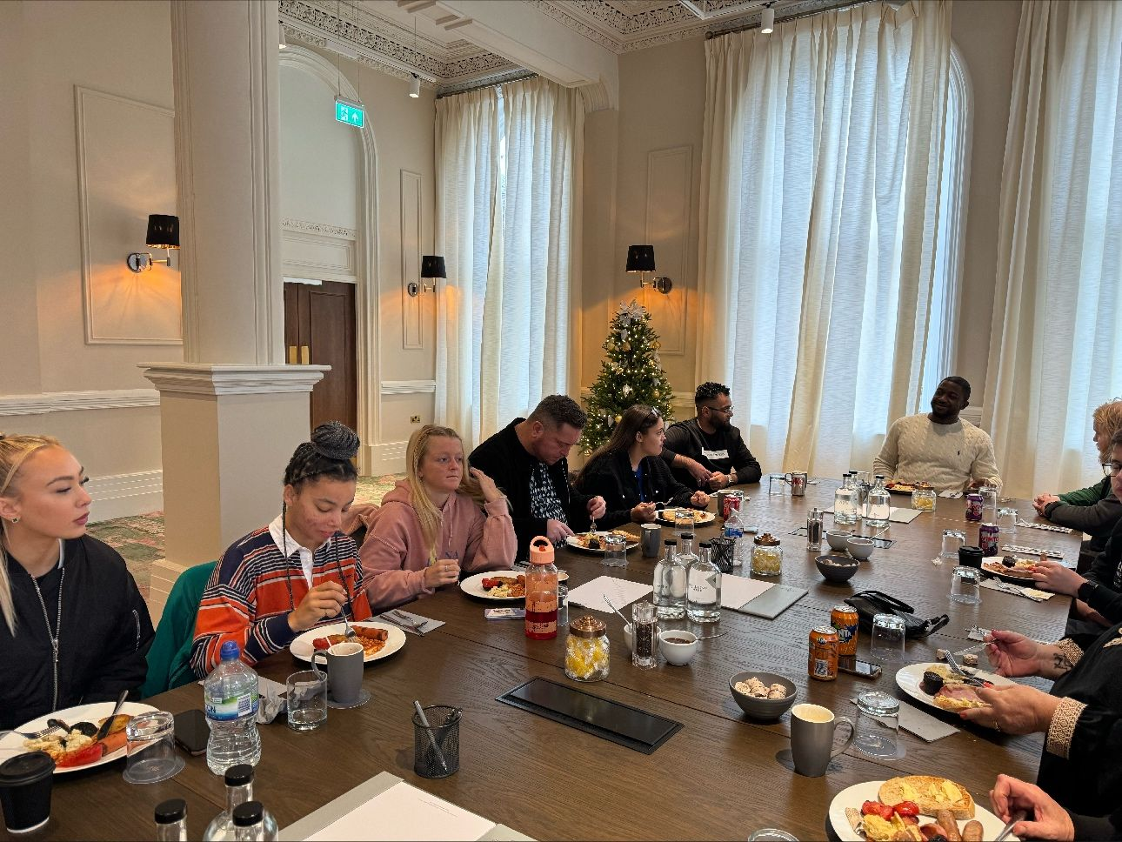
What are Experts by Experience?
Experts by Experience are people who have lived experience of using or caring for someone who has used health and/or social care services.
At Cygnet we make a clear distinction between the two, in order for us to be able to harness service line specific lived experience in the most meaningful way.
All of our Experts by Experience have been within in-patient services. This is important to mention as the concept of ‘lived experience’ is often stretched to include people who have experienced mental distress in the community at any point in life.
Whilst lived experience in any form is important and has value, in the in-patient context, we feel it is not so much about experiencing mental distress or having a diagnosis, but the unique perspective of having experienced detention under the mental health act.
We also have a team of Family Carers who support us and are recognised as Family Carer Experts by Experience and champions.

Slide 11
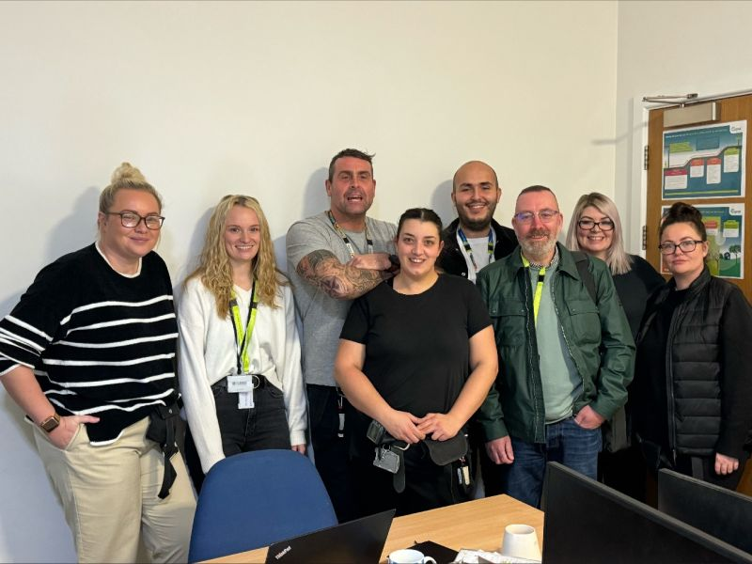
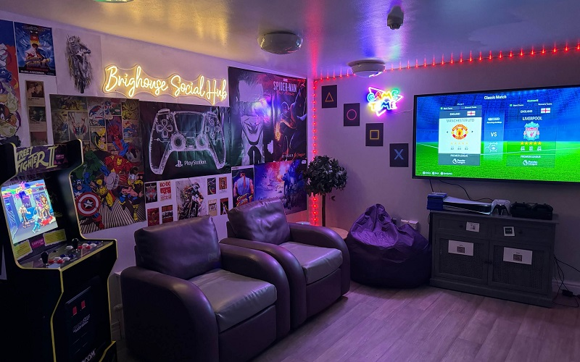
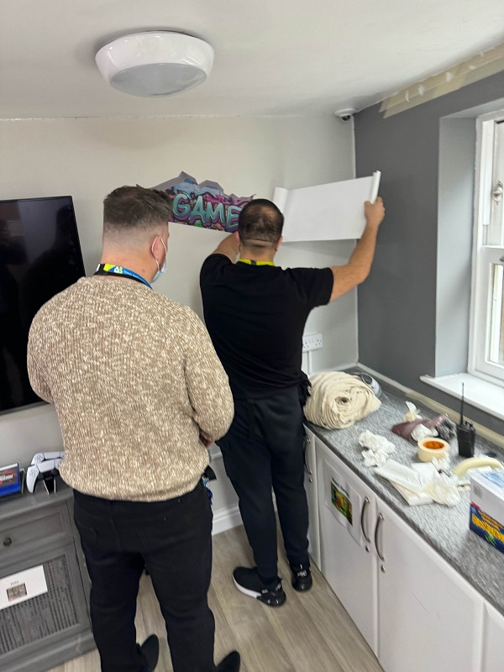
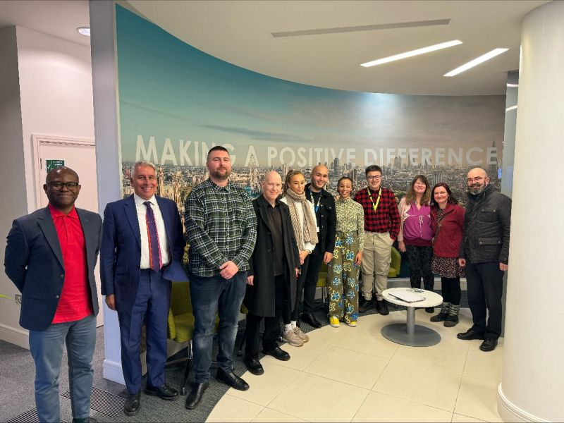
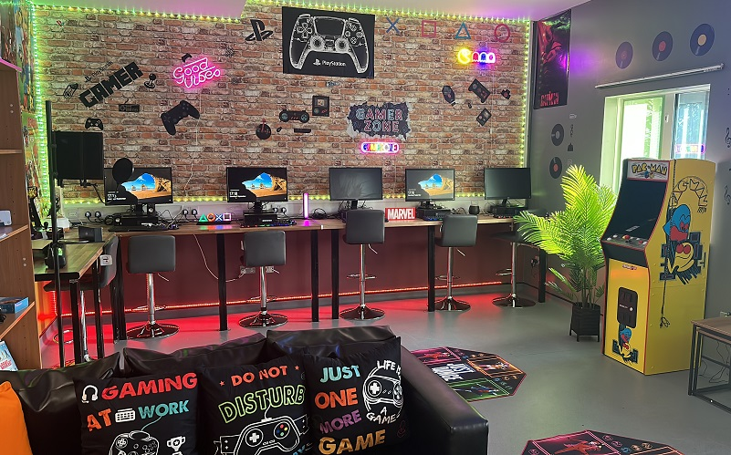
What do Experts by Experience do?
On a local level Experts by Experience visit our services on a weekly basis and many work part-time. This is done through an independent support organisations who provide extra support, reasonable adjustments and ensure a level of independence.
Some Experts by Experience may also work across a number of services which amounts to full time employment.
They primarily provide peer-support, capture feedback and support various forums, projects and initiatives. This can include Staff training, culture change, environmental improvements, Quality Improvement projects, research and supporting implementation of actions generated from their feedback.
On a strategic level Experts by experience support us with everything from policy change to national and organisation wide projects and initiatives.
We also have various meetings, boards and committees which have expert by experience representation including a Lived Experience Advisory board which is attended by the Group CEO.
A monthly virtual drop in session with our CEO is also facilitated to support with having a ‘finger on the pulse’ operationally and ensures people with lived experience have a voice at every level of the organisation.

Slide 12
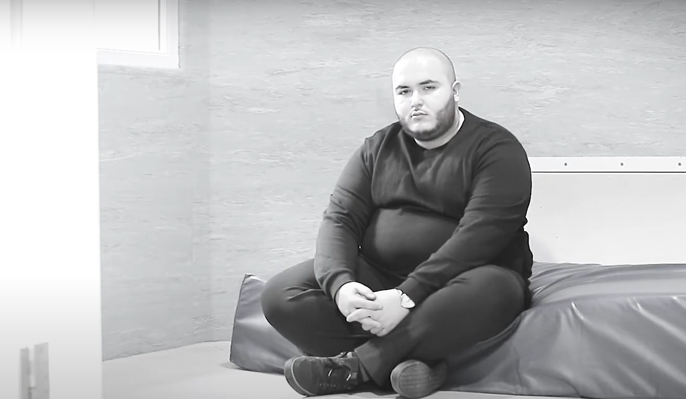
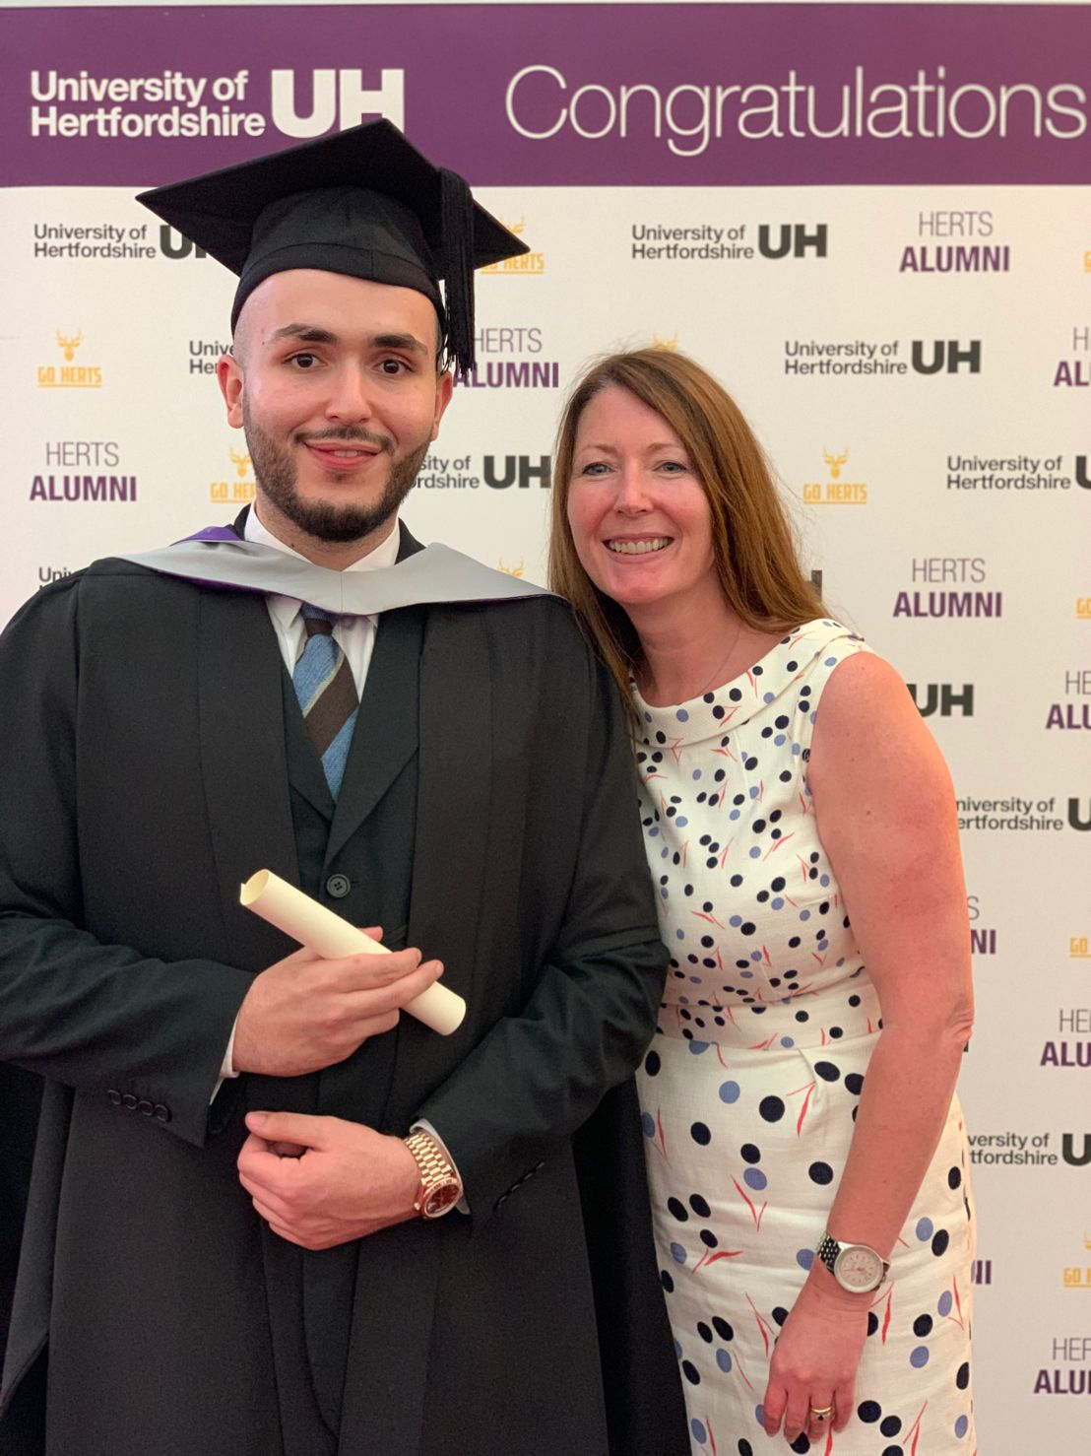
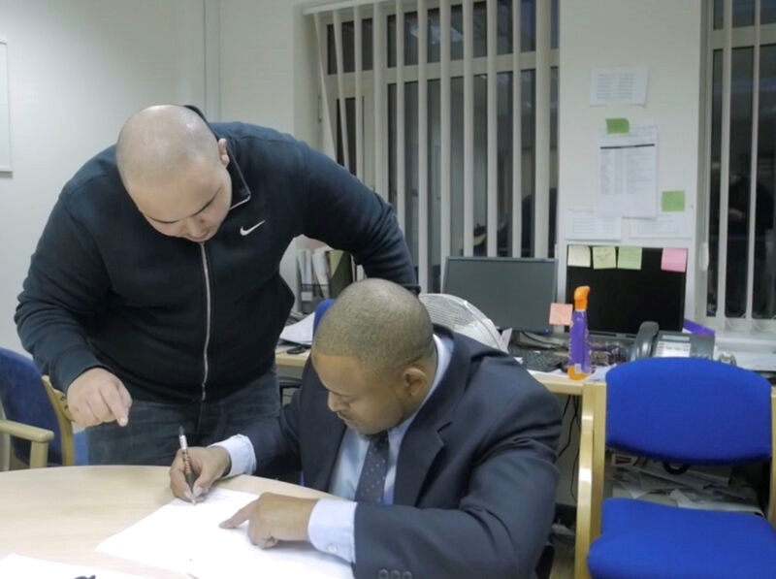
The benefits
Personally
Experts by experience in the in-patient context benefit from employment which supports:
Having purpose, confidence, self-esteem and hope.
New circle of friends, peer support, a positive social life and new support structures.
Financial security and the ability to live a meaningful life beyond diagnosis.
New skills, independence and opportunities
Connectedness and being a productive member of society.
Organisationally
Organisations benefit from authentic experts by experience by:
Having a unique perspective to support with quality improvement and culture change.
Ensuring there is lived experience involved in decision making which supports buy-in and simply, getting it right.
‘Having a finger on the pulse’ to assist with where attention is required (i.e hotspots) and general sentiment.
Capture richer feedback from a lived experience perspective and support with the implementation of actions.
Economically
The health and wider economy benefit by ensuring:
Cost of bed days: Former service users avoid being re-admitted through the prevention provided by employment with a little extra support.
Benefits: Getting off of employment and housing benefits etc.
Tax: Being able to give back and contribute to society through becoming tax paying citizens.
Sector wide and society
The sector and society more broadly benefits as:
Many Experts by Experience go on to join the workforce in different roles such as Occupational therapy, nursing and beyond.
Beds which are needed by others in desperate need become more available.
Communities with higher prevalence's of in-patient MH admissions and unemployment rates have another opportunity to assist with recovery.
Quality and culture improves across the board raising the bar on standards, on a national level.
Rehabilitation and recovery can enhance public safety by preventing crisis which may result in forensic admissions.

Slide 13
How EbEs have supported this project?
EbE input alongside the projects leadership (Co-authoring)
Design of the project (i.e photovoice)
Advisory group providing lived experience oversight and steer
EbE support on the ward throughout (Increasing participation and meaningful engagement).

Slide 14
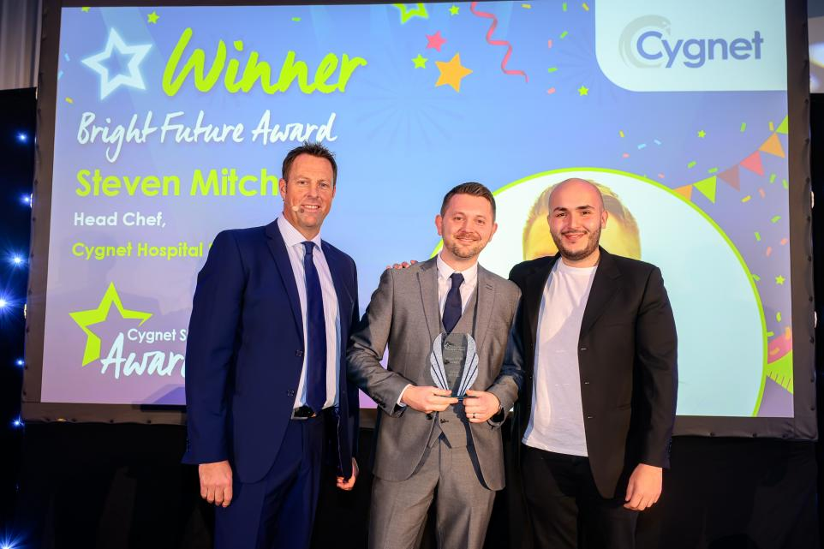
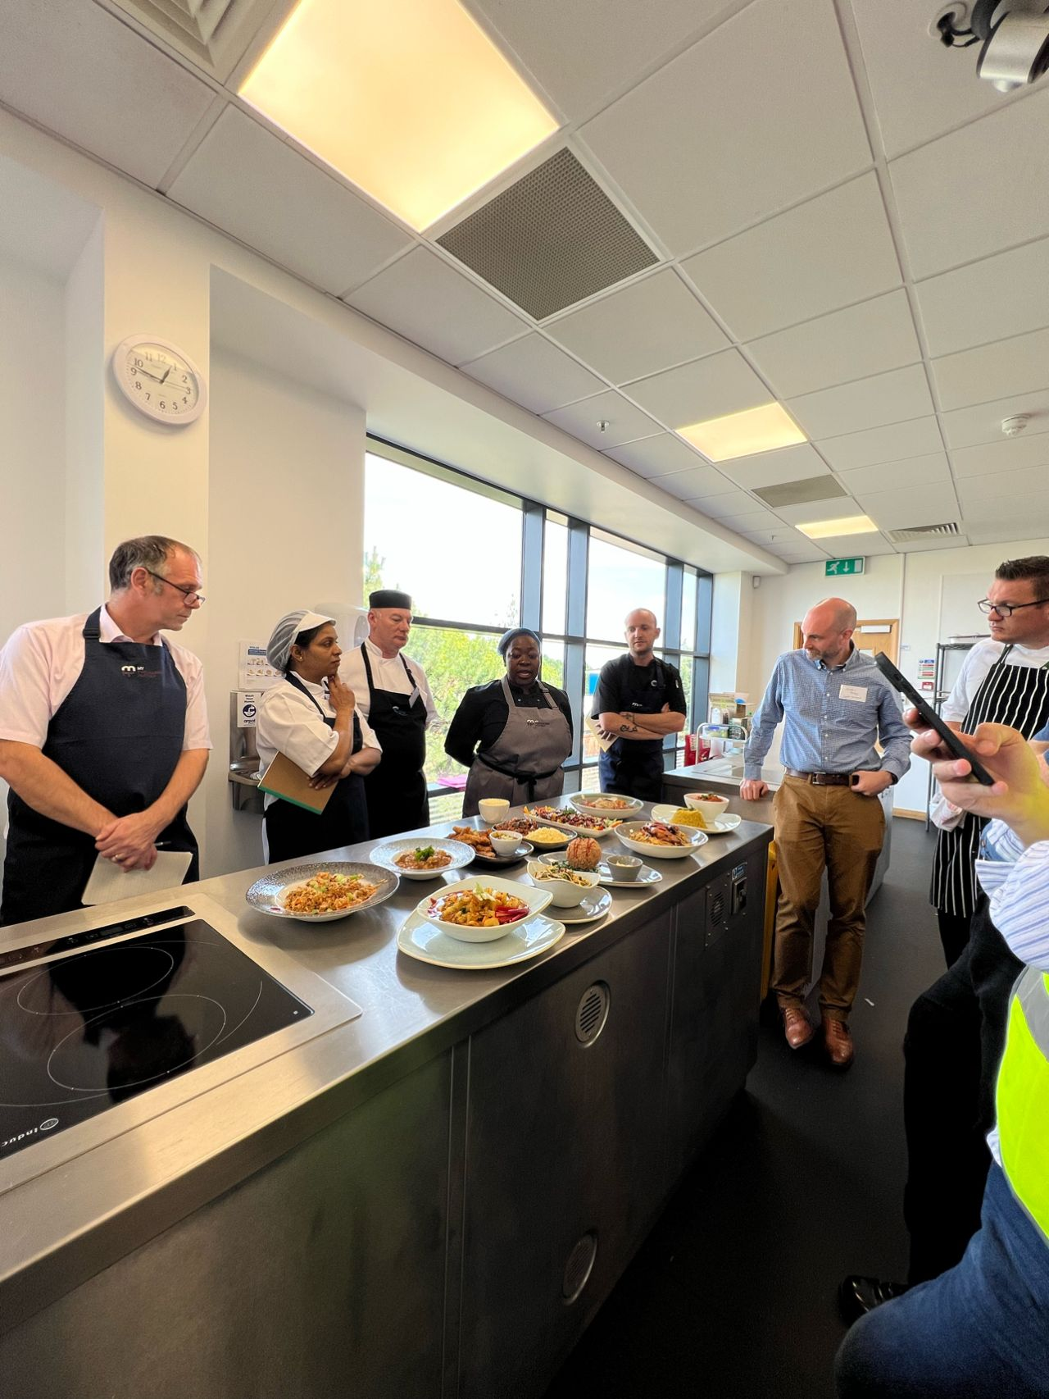
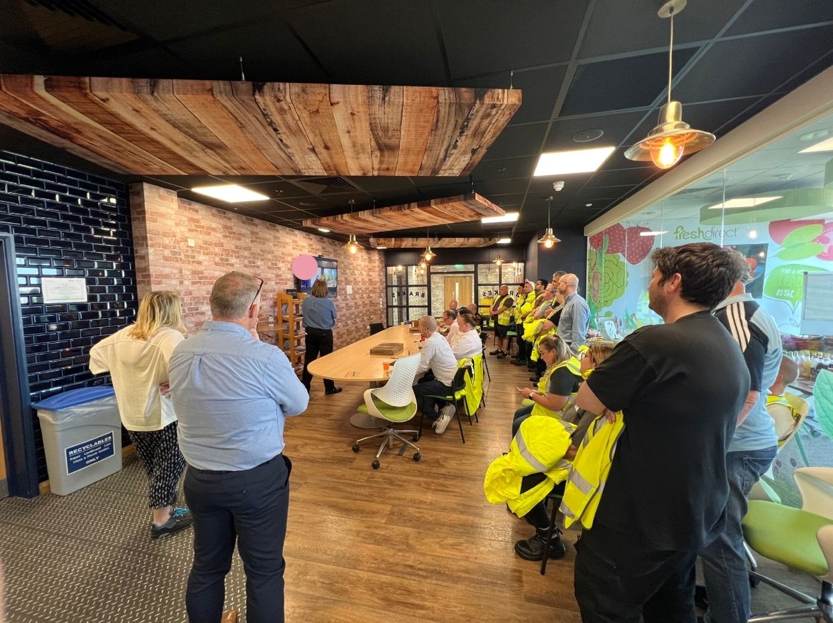
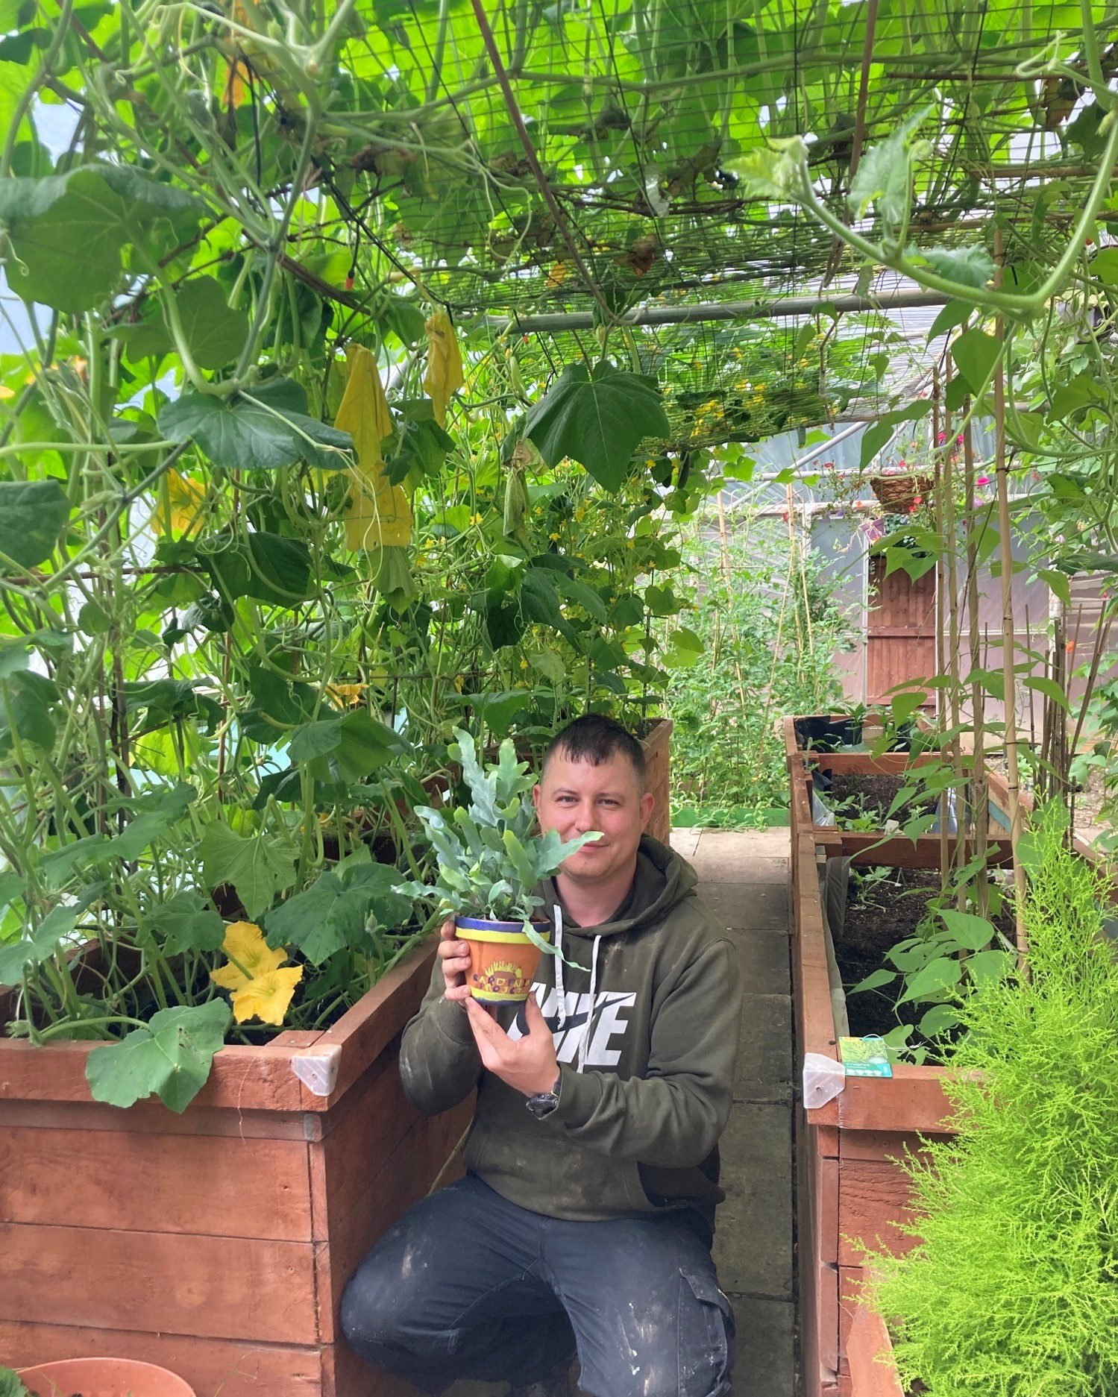
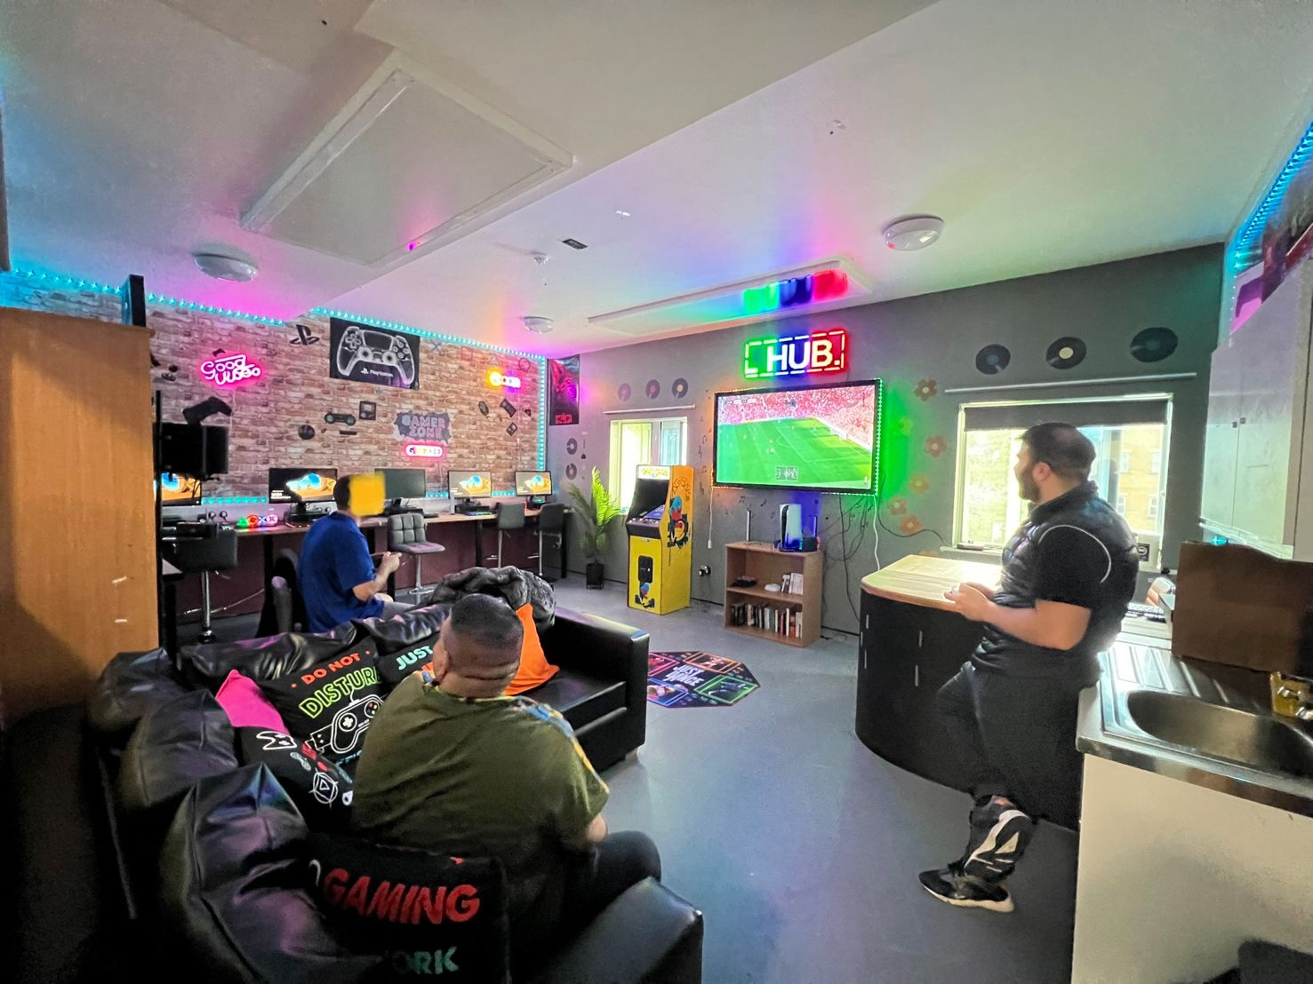




Further information and resources
Video on Raf’s Journey: ‘My journey to becoming expert by experience lead at Cygnet’ (by Raf Hamaizia): https://www.youtube.com/watch?v=uL_EkBAJ3WA
Peoples Council – Embedding service user forums into our governance structure: https://www.cygnetgroup.com/service-users-carers/co-production-at-cygnet/peoples-council/
Music 2 Empower – Supporting music therapy and showcasing lived experience talent: https://www.cygnetgroup.com/service-users-carers/co-production-at-cygnet/music-2-empower/
Co-sustain- Raising awareness and providing access to re-cycling in MH services: https://www.cygnetgroup.com/service-users-carers/co-production-at-cygnet/co-sustain/
Recovery Colleges – Providing recovery oriented learning and development on site: https://www.cygnetgroup.com/service-users-carers/co-production-at-cygnet/recovery-colleges/
The Yellow Book – Co-produced self help and well being initiative: https://www.cygnetgroup.com/service-users-carers/co-production-at-cygnet/the-cygnet-health-care-yellow-book/

Slide 15
Deinstitutionalisatin from within: Results
Joanna Fox
Anglia Ruskin University
Joanna.Fox@aru.ac.uk

Slide 16
Sample
10 women interviewed over course of 1.5 years of data collection in 3 cohorts out of a potential sample of 16 at any time on the ward
Full data collected for 3 women, with the remainder mostly giving 2 interviews and permission for all professional reports to be collected
Data reached saturation with sample
Difficult to engage this client group due to levels of anxiety, distress and fluctuating wellbeing / commitment to project
Ongoing and dedicated support from ward staff, EbE support on ward, and EbE representing organisation has been essential

Slide 17
Professional reports: Reduced critical incidents
Pseudonym | Period 1- number of incidences | Types of incidents | Number of particular incidents | Follow up care provided
Angel | 20 | Suicidal behaviour Ligature Cutting | 1 18 1 | Taken to A&E None None
Bluedog | 9 | Suicidal behaviour Ligature Headbanging Burning with aerosol Cutting | 2 2 3 1 1 | Taken to A&E (1) Restraint to remove ligature (1) None Taken to A&E First aid given
Pseudonym | Period 2 Number of incidents | Type of incidents | Number of particular incidents | Follow up care provided
Angel | 9 | Suicidal behaviour Ligature Cutting Punched wall Security incident | 1 5 1 1 1 | Taken to A&E None None None None
Bluedog | 6 | Headbanging Cutting | 4 1 | None None
Period 1 31.01.24 – 01.05.24
Period 2 15.05.24 – 15.08.24

Slide 18
Theme 1: Planning for successful transition
The focus on long term goals and transition is developed by engagement on the ward. Roadmanjobs notes:
  We talk a lot about like values and sticking to those values to make a life worth living. And since I’m in a much better place now, I’m more able to understand. (Data collection period 1)
This is supported by effective transitions planning, as detailed by Superstar.
  Discharge book… Yeah, if there is a plan then they discharge you near my mum’s. I got photos in my discharge book I’ve got my hobbies. What I like, what I don’t like, what I wanna live in a bungalow. And just pictures really. (Data collection period 1)

Slide 19
Supporting data
Purplestacey found it hard to envision a future outside of mental health services but would like to go to college to study childcare. However, she couldn’t identify the steps towards the goal, stating:
  Not really at the moment, cause trying just focusing on myself until I actually know what I want with my life when I’m out of here. (Purplestacey, interview, data collection 2)

Slide 20
Theme 2: Self esteem and worth
The feeling of self-worth and the role of self-esteem and ambition are key parts of recovery and transition to the community. Shared decision making is about sharing power between people involved in a mental health consul tation process and enabling the best outcomes to be achieved for the service user, in partnership with the staff (Ramon et al., 2017).

Slide 21
Supporting data
The emphasis placed on valuing expertise by experience is key to building self-esteem. Being a ward peer support facilitator has given Greenfrog a sense of responsibility on the ward T
  It’s helped me feel like it’s helped me feel like more, I don’t know, like, independent and, like, responsible for something. (Greenfrog, data collection period 1)
Greenfrog reported how in preparation for discharge, she managed her own medication, remembering the times and dosage – thus taking responsibility for her own care.
  I mean on this day I was able because I have them in my room, I was just able to like, take my meds out with me and that was nice, like not having to ask for permission. I can just like give my own meds.

Slide 22
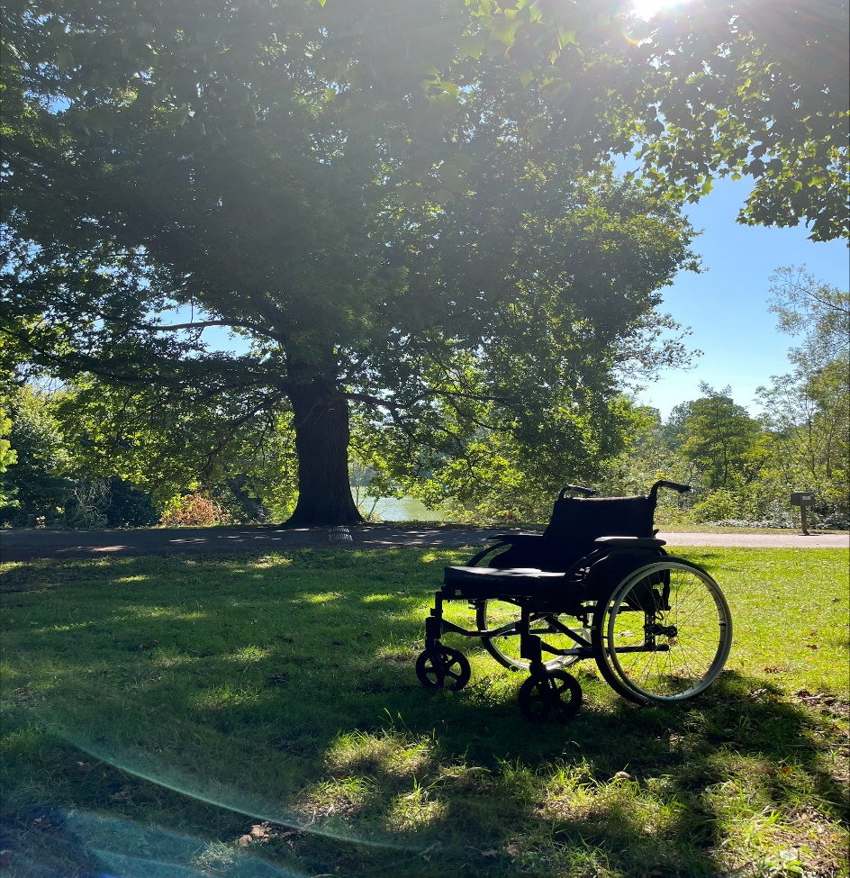
Theme 3: Hospital environment, activities and meaningful occupation
Walk and talk group
Paradoxically, the wheelchair represents freedom with restrictions. It gives Greenfrog the freedom to go out with friends but also restricts and limits her access. She experiences pain when walking and using crutches. (data collection 1)

Slide 23
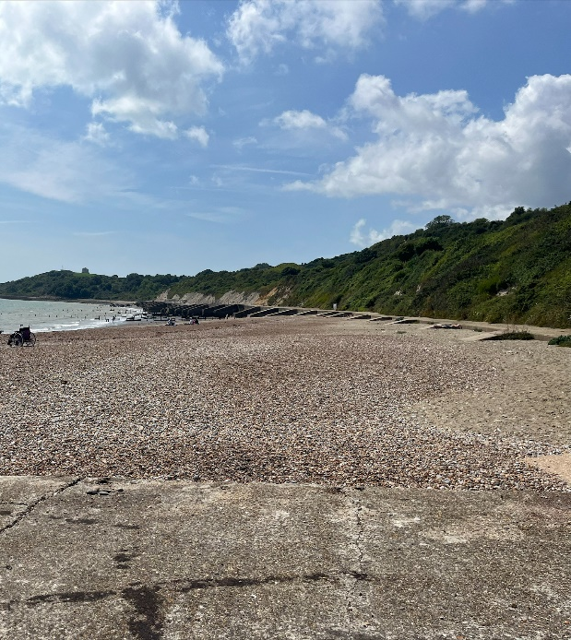
It's like it's similar like freedom and choice and doing things that I want to do. And I mean I feel like the wheelchairs like further in the distance and maybe that's like the next stage of my life being further away from that stuff. I mean being able to maybe manage without it or with using it less. Maybe. Hopefully in the next three months it won't be in the photo at all… In the last time (data collection 1, photo) it was like right near the front and like very much of that and in the space, I feel like it's still it's still there, but it's like. It's a smaller thing. (Greenfrog, interview, data collection 2)

Slide 24
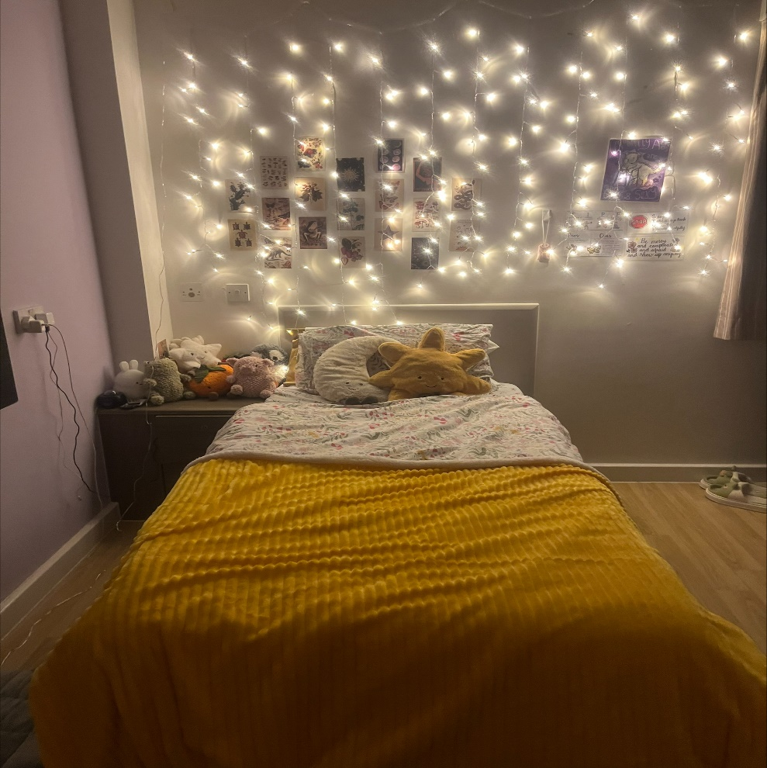
This is my room on the ward now. I think it just like when I came here, my room was completely empty. Like I just had the light blue mattress and the old blanket and now I've got like all of my own stuff that were more covered in fairy lights and it just makes me feel like I've come a long way. (Greenfrog data collection period 1)

Slide 25
Theme 4: Relationships and systems
  Relationship based practice at the basis of all care
  No. It's different to any other hospital I've been to how the staff treat you, and I think it's better (Purplestacy data collection period 1).
This positive relationship is reported despite Purplestacey’s sometime apparent indifference, as reflected in the DBT report provided by staff:
  Purplestacey can appear to act as if they are indifferent, when in discussions with the team. This has often been because they are expecting a negative experience and to be told they are not engaging effectively (Purplestacy data collection period 1 DBT report)

Slide 26
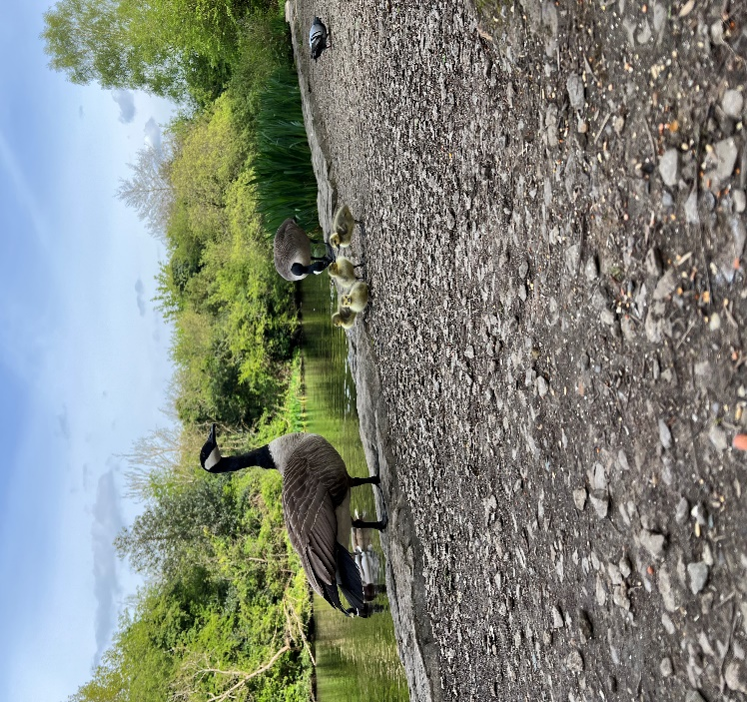
Supporting data
Building and modelling relationships
I've spent a lot of money on bird food and it's been worth it because the impact that they've had on me is huge as well, and it's somewhere that I've gone even on the days where I'm feeling the worst and when it's been hardest to stick to recovery, I've gone there and I've practised mindfulness and... And it's been someone where it's safe to do that (Simon Garfunkel data collection period 1).

Slide 27
Summary
The inpatients resident in Daffodil ward are women in need of safety
  a history of engaging in serious acts of self-harm before entering, most often, under compulsory admission.
A closed ward can be a place where misuse of power and authority can occur
  as the experiences of people with learning difficulties in Winterbourne View reflects (DH, 2012).
  The introduction of EbEs, who regularly visit the ward, promotes a culture of openness and transparency which enables the redistribution of power and reinforces the importance of listening to the user voice (Faulkner et al, 2010).
The innovations represent a process in which transition back to the community is at the forefront of all planning.

Slide 28
Conclusion and Limitations
The cumulative evidence base, building on the Springbank model, suggests that such a model has real implications for future practice and has the potential to provide a future frame for effective hospital-based care delivery for biological women with PD/BPD.
The small sample means that the evidence base has some limitations, and future research would need to be conducted to consider its overall effectiveness.

Slide 29
References
DH (2012) Transforming care: A national response to Winterbourne View Hospital: Department of Health Review Final Report https://assets.publishing.service.gov.uk/media/5a7b91f7ed915d13110601c3/final-report.pdf
Faulkner, A., Sadd, J., & Hughes, E. (2010). Lived Experience Leading the Way: Peer Support in Mental Health. Together for Mental Wellbeing.
Fox, J. Ramon, S., Hamaizia, R. (2025) The process of deinstitutionalisation from within an institution: evaluating innovations in a closed ward for women with (borderline) personality disorder. Socialno Dello. Doi:10.71741/sd.2025.64.1-2
Han, C.S., Oliffe, J.L. (2016) Photovoice in mental health research: A review and recommendations. Health 20(2) 110-126. doi.org/10.1177/136459314567790
Hernandez-Bustamante, M., Cjuno, J., Hernández, R. M., & Ponce-Meza, J. C. (2024). Efficacy of dialectical behavior therapy in the treatment of borderline personality disorder: a systematic review of randomized control trials. Iranian Journal of Psychiatry, 19(1):119–
129. DOI: 10.18502/ijps.v.19i1.14347
Linehan, M. M. (2011). Dialectical behavioral therapy: a cognitive behavioral approach to parasuicide. Journal of Personality Disorders, 1(4), 328–333. DOI: 10.1521/ pedi.1987.1.4.328
Nagrodski, J., & Zimbron, J. (2019). Attitudes towards Borderline Personality disorder Unit: a small- scale qualitative study. Pyschiatria Danubina, 31, supplement 3, 626–631.
Stovell, D., Morrison, A., Panayiotou, P., & Hutton, P. (2016). Shared treatment decision-making and empowerment-related outcomes in psychosis: systematic review and meta-analysis. The British Journal of Psychiatry, 209(1), 23–28. DOI: 10.1192/bjp. bp.114.158931

Slide 30
Thank you

