Slide 1
SENSORY MODULATION STRATEGIES FOR WARD STAFF
Theoca Moodley
Head Occupational Therapist
Godden Green

Slide 2
CONTENTS
Rationale for training
What are sensory strategies?
What can sensory modulation help with?
Benefits for staff?
Exploring the senses using a ‘’sensory cap’’
Sensory processing differences explained and explored
Person, environment and occupation domains
Modulation techniques

Slide 3
RATIONALE FOR THIS TRAINING
?
Evidence- based practice in supporting service users in distress to decrease incidents of violence and aggression on the ward
Sensory QI implemented
Sensory QI’s are being piloted across all acute and PICU hospitals, led by OT departments, to improve quality of care, decrease incidents of violence and aggression, improve therapeutic relationships between staff and service users as well as the overall care environments
At Godden Green the QI showed decreased incidents of violence and aggression over May- August 2023.
Staff training and support in managing signs of distress and subsequent challenging behaviours using a non-medical model
Skills development that is transferable to all aspects of personal and work lives
Notes:
Request from external OT teams for support with similar interventions in their service lines

Slide 4
Foundational Staff Training
Julie O’Sullivan & Carolyn Fitzgibbon
Sensory Modulation Brisbane
On-demand training packages
Live on-line consultation sessions
Notes:
Request from external OT teams for support with similar interventions in their service lines

Slide 5
WHAT IS SENSORY MODULATION (SM)?
Ability to respond and remain at an appropriate level of alertness
We make sense of sensory information from the environment and our own body to learn and behave
HOW we regulate this sensory input in order to prevent us from over/under reacting to sensations.
‘’Using our senses to change how we feel’’
(O’Sullivan & Fitzgibbon, 2023)
Sensory Modulation is NOT Sensory Integration- SM can be offered by ANYONE
We use Sensory Modulation every day as humans
Notes:
Sensory modulation is the ability to respond appropriately to sensory information and remain at an appropriate level of alertness for activities.
We make sense of sensory information that we receive from the environment and our own body in order to learn and behave in appropriate ways. Sensory modulation is how we regulate this sensory input in order to prevent us from over or under reacting to sensations. Difficulties with sensory modulation can result in being under-responsive (decreased response) or over-responsive (increased response and alert levels).

Slide 6
THE ALERT LEVELS
(Sensoryladders.org, 2024)
Notes:
Important to note that over arousal can lead to a state of severe under-arousal following the hyper arousal incident for some people.

Slide 7
WHAT CAN SENSORY MODULATION HELP WITH?
Focus
Calming
Feel safe
Grounding
Alternative to self- harm
Cope with pain, illness, grief
Cope with urges for substances
Pleasure
Reproduced with permission from Sensory Modulation Brisbane, 2023
Notes:
↑ recovery, self-management and autonomy*
Trauma informed care →feelings of safety**
↓ reliance on PRN

Slide 8
Who can use sensory modulation techniques?

Slide 9
WHAT ARE THE BENEFITS FOR STAFF?
EBP
Safe
↓Incidents
Time effective
Job satisfaction
Alternative method to medicine
Changes YOUR feelings
It provides opportunities for patients and staff to understand their own sensory preferences and needs, building autonomy and self-efficacy when in crisis
Reproduced with permission from Sensory Modulation Brisbane, 2023
Notes:
Safer for Clinicians - ↓ incidents
Saves time: ↓ paperwork (for incidents) ↓ documenting & observing PRNs
↓ need for seclusion and restraint (Sutton & Nicholson, 2011)
Modelling the skills changes how clinicians feel
Success with skills ↑ client engagement and positive help seeking, ↑job satisfaction for staff
A different way of looking at & addressing behaviors -sensory explanation and a sensory
solution• a sensory solution can still help a non
sensory problem
Evidence based practice!

Slide 10
EXPLORING THE SENSES
SENSORY
CAP

Slide 11
BEFORE WE START…
(Image: Dreamstime.com)
Notes:
Let’s discuss driving a car. What senses do we use?
Sometimes we end up somewhere and cant remember how we go there- how is this possible?
What do we do if we feel tired or on the way; music, open the windows; chatting etc.

Slide 12
THE ‘’OG’’ SENSES
Sight
Hearing
Smell
Taste
Touch
Notes:
The original gangster senses

Slide 13
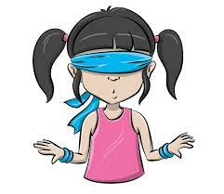
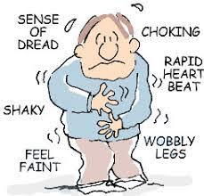
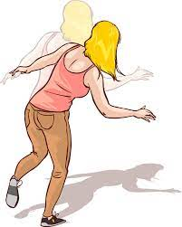
BUT WAIT! THERE’S MORE!
PROPRIOCEPTION
INTEROCEPTION
VESTIBULAR
(Image: CBT4Panic & DizzyDoctor)
Notes:
Proprioception, also called kinaesthesia, is the body's ability to sense its location, movements, and actions. It's the reason we're able to move freely without consciously thinking about our environment.
Interoception is our sensory system that provides information about the internal condition of our body—how our body is feeling on the inside. Interoception gives us the body sensations such as a growling stomach, dry mouth, tense muscles and racing heart.
The vestibular sense, also known as the movement, gravity and/or balance sense, allows us to move smoothly. We are able to maintain our balance while engaged in activities because of this sense. While vestibular helps us with balance while we walk and run, it also helps us stay upright when we sit and stand.

Slide 14
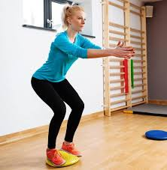
PROPRIOCEPTION
Awareness of how our muscles are moving
Essential to help the brain to know where the body and limbs are in space
Different to TOUCH: Proprioception input comes from muscles and joints, not skin
We have receptors in muscles and joints which respond to body movement and position
Helps us to know how hard, soft, fast or slow we are pulling or pushing
Helps with grading of pressure and speed- think about cracking an egg!
Works with vestibular sense to help with balance
(Image: Conseil Sante)
Reproduced with permission from Sensory Modulation Brisbane, 2023
Notes:
If we use too much force or speed we break things. If we use too little then we might not be successful. When hammering in a nail, for example, if you hit too hard you might bend the nail, but if you hit too softly it won’t go in. Cracking an egg is another great example, if you tap too lightly it won’t open, but if you crack it too quickly or with too much force you will be cleaning up a mess!

Slide 15
INTEROCEPTION
Perception of the body’s internal state (hunger, thirst, breathing, heart rate, nausea, pain, toileting etc.)
Internal sensations help to interpret and be aware of emotions
Associated with learning, decision making, emotional awareness and regulation and alexithymia
Reproduced with permission from
Sensory Modulation Brisbane, 2023
(Image: CBT4Panic)
Notes:
Alexithymia- the inability to recognize or describe one's own emotions.

Slide 16
VESTIBULAR
SENSORY MISSING/LOW IN REGISTRATION
Appears as clumsy, often falling over, tripping and losing balance.
Looking at the floor while walking.
Be able to spin in circles for a long time without becoming dizzy.
Have a poor awareness of safety such as running into objects without noticing.
Be unable to follow moving objects, such as cars with their eyes.
Movement sense:
Head position
Speed
Gravity
Detected in inner ear
Reproduced with permission from
Sensory Modulation Brisbane, 2023
(Image: DizzyDoctor)

Slide 17
SENSORY PROCESSING DIFFERENCES FOR EACH SENSE
Sensory missing/Low registration
Sensory seeking
Sensory avoidance
Sensory sensitivity
(O’Sullivan & Fitzgibbon, 2023)
Notes:
Sensation isn’t notices until the input is intense or new- never felt before- talk about babies trying lemon for the first time after eating bread/chocolates- which sense? Or one of those hot coal walkers?
To feel ‘’alive’’, the input needs to be intense and new- think about how some people are adrenaline junkies- Thorpe park and rides – which sense/senses?? (vestibular and proprioceptive and Interoceptive (fear?)) – in the same way, think about intense tastes- sometimes these can make you feel alive or alert and awake (Lemon, chilli etc.)
A little bit of the sensation feels like A LOT and too much to handle (think about Misophonia- when someone is breathing loudly or chewing
A little bit of sensation feels too much and so it is avoided- can avoid bathing or showering, can avoid noise by using noise cancellation headphones (modulation device)
Ask for examples for each processing difficulty from the staff- lets think about patients in our ward and what we have observed.

Slide 18
DIFFERENT THRESHOLDS FOR DIFFERENT SENSES- UNIQUE is an understatement!
Can, for example, be a seeker for touch, but sensitive to movement/vestibular and proprioception
Can fluctuate between two extremes
Can be impacted by trauma, physical difficulties and stress
Can impact life and how one goes about their activities of daily living
Reproduced with permission from Sensory Modulation Brisbane, 2023

Slide 19
LET’S EXPLORE OUR SENSORY PREFERENCES
Complete the sensory spiders
First complete your signs of distress and triggers
Make a note of what makes you feel;
calm when stressed
alert
Under aroused (sleepy)
Let’s compare our sensory needs and preferences to highlight our uniqueness!
Explore different sensory tools on the table

Slide 21
EXPLORING SENSORY NEEDS FURTHER; What sensory triggers are there?
PERSON
ENVIRONMENT
OCCUPATION- DAILY ACTIVITIES
Notes:
PERSON
Mental illness
Trauma and life experiences
Substance use
Relationships
Physical health
Sensory preferences
ENVIRONMENT
Inpatient units- being in hospital
Shared/independent spaces
Bedrooms and bathrooms
Clinical rooms
Sensory spaces
OCCUPATION- DAILY ACTIVITIES
Facility activities (program)
Showering, eating sleeping, dressing
Exercise and movement
Engagement with others

Slide 22
LET’S WATCH A VIDEO OF SOMEONE EXPERIENCING A SENSORY OVERLOAD
https://www.parentingspecialneeds.org/article/experience-sensory-overload/
Please step out if you have a sensory overload or sensitivity to loud and repetitive noise

Slide 23
DEBRIEF AND THOUGHTS

Slide 24
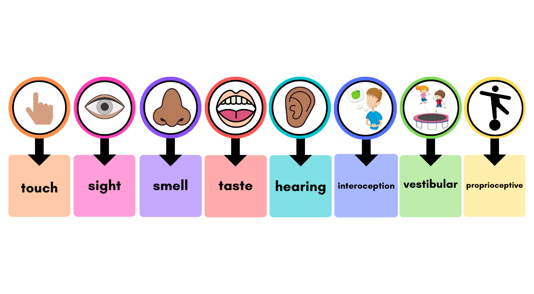
HOW WOULD WE OBSERVE SENSORY SENSITIVITY AND LOW REGISTRATION PER SENSE? IMPLICATIONS?
Notes:
Discuss observations of cases on the ward
Touch- Low registration (touching something hot, no pain?- dirty hands, cannot feel dirt- or mouth with food around it), sensitivity (avoids touching- can become upset or angry if we are too close within person space (patient example JP)
Sight (LR- dangerous- cannot see, can walk into a busy road, might bump into things due to sight etc.), Sensitivity (light, darkness, strobe lights- headaches and pain)
Smell (LR- no smell- implications for personal hygiene- cannot smell BO, sensitivity- cannot focus, becomes upset or uncomfortable with scents- some humidifier scents can be uncomfortable and frustrating. Think of how uncomfortable it would be to be surrounded by poop smell all the time- never goes away, stays the same- intense and poopy. Would be uncomfortable no? trauma related?
Taste (LR- burn mouth, too spicy/salty etc.,; sensitivity- could avoid certain foods or stop eating
Hearing (LR- cannot identify danger sounds, sensitivity- too much, cannot differentiate between sounds, overwhelming
Interoception (LR- incontinence appearance? Not eating, drinking until too late, sensitivity: lots happening inside body- can be misinterpreted (anxiety can feel like a heart attack)- hypervigilance to sensations felt
Vestibular: LR- increased risk of falling due to this- medication can affect this (blur the ability to register when sedated); sensitivity- jumpy, anxious, poor balance, motion sickness etc.
Proprioception: LR- bumping into doorways, falling off chairs, walking into people, sensitivity: too much- dislikes exercise and heavy weights/pressure (if seeking- would benefit from deep pressure and exercise)

Slide 25
HOW WOULD SENSORY PROCESSING DIFFICULTIES THIS AFFECT OCCUPATIONAL ENGAGEMENT?
PERSONAL MANAGEMENT
SOCIAL ABILITY
USE OF FREE TIME
WORK ABILITY
Notes:
PERSONAL MANAGEMENT
Self care
domestic skills
financial skills - budgeting
daily/weekly routines
motivation & self esteem
personal safety
community living skills
understanding my mental health
USE OF FREE TIME
exploring & developing hobbies & interests
relaxation activities
managing social isolation
community engagemen
SOCIAL ABILITY
managing anxiety in social situations
communication skills
relationships
roles & responsibilities
community engagement
social confidence
confidence in the community
WORK ABILITY
setting recovery goals
developing concentration/attention
decision making
memory
functional skills
vocational training
problem solving

Slide 26
Let’s identify some environmental triggers on our wards- together
Notes:
Need papers and pens- split up into groups and let the teams complete a list of environmental triggers on the ward

Slide 27
ENVIRONMENTAL SENSORY TRIGGERS
SOUND
Alarms, buzzes, phones
Trolleys, carts
Heavy doors opening and closing
TV volume/sounds
Patients shouting/crying/screaming etc. (incidents)
LACK of nature or familiar sounds
SMELL
Cleaning products
Food smell
Toilets
Body odour of self or others
Diffused scents
Perfume/aftershave
TOUCH
Temperature
Injection (alcohol swab, needle insertion, pain)
Swallowing tablets
Restraint and lack of consent for touch
VESTIBULAR/MOVEMENT
Decreased opportunity for physical activities; exercise or incidental activities (gardening, shopping, laundry, cleaning)
Concerns about how movement is perceived in the ward- sign of escalation or is it a self-management strategies?
SIGHT
Fluorescent lights
Lights at night during obs- torches
Shiny linoleum
The institution and furniture (clinical looking)
LACK of access to nature or familiar sights
ENVIRONMENT ASPECTS
Reproduced with permission from Sensory Modulation Brisbane, 2023

Slide 28
Let’s identify which ward areas are alerting, calming or just right in terms of sensory triggers Then let us look at where we would find loud noise, smells, relaxation and busy areas
SENSORY HEAT MAPS
Notes:
Print out heat maps of the hospital and split them amongst the team and let them work on that

Slide 29
SENSORY HEAT MAP EXAMPLE
PICU Ward sensory heat map

Slide 30
MODULATION TECHNIQUES FOR THE ENVIRONMENT
CULTURE OF SENSORY SPACES
Sensory room
ALARMS AND SOUNDS
Change the sound of the alarm
DECREASING SCENTS
Nil odor
Encourage washing clothes o prevent BO
Furniture
Individuals preferences
Access to fresh air and nature walks
Posters to show alarm times
Provide earphones before alarms go off
Pot pour- can make own (scented bags)
Solutions for showers
Continence issues solutions
Ear plugs, sound machines
TORCH LIGHT OBS
Bed assist pressure monitor
Pulse oximeter
Fitbits
Withings sleep tracking mat
Sleeptight pressure sensor
Lamp, colored torches, mask, dimmed lights
Reproduced with permission from Sensory Modulation Brisbane, 2023

Slide 31
SENSORY PROCESSING DIFFERENCES AND DIAGNOSES
Sensory processing differences are not isolated to 1 or 2 diagnoses: ASD, SCZ, BAD, Depression, PTSD, OCD, ID/LD, Brain injury and Dementia, ADHD, Fragile X, William Syndrome, Down Syndrome
Sensory processing and risk of aggression:
Decreased processing= Threat response
Sound and noise sensitivity when acutely distressed
SCZ- processing internal states and sensations can be difficult (aggression not pre-meditated)
Reproduced with permission from Sensory Modulation Brisbane, 2023
Notes:
Inability to process what is happening may increase a threat response
Acutely distressed= become oversensitive to noise and bright light or under responsive to other input like visual cues
‘’Autistic adults with higher scores in sensory sensitivity had the highest risk of aggressive behaviour’’ (Van den Boogert et al., 2021)
SCZ; difficulties with processing sensations and internal states could increase aggression (not pre-meditated)

Slide 32
CASE STUDY

Slide 33
WHAT PROCESSING DIFFICULTIES CAN YOU SPOT?
XB is a 34 year old female (pronouns: she/her) with diagnosis of Schizoaffective disorder admitted to PICU ward
Observed wearing many layers of clothing all the time within the ward, jumping on furniture and running up and down the passages when frustrated. Punches the wall and doors at times. Doesn’t appear to eat during lunch time and doesn’t use her water bottle. Stays in the communal area- near the window for most of the day. Shouts at others when they are playing loud music. Doesn’t attend group sessions.

Slide 34
WHAT PROCESSING DIFFICULTIES CAN YOU SPOT?
XB is a 34 year old Female with diagnosis of Schizoaffective disorder admitted to PICU ward
Observed wearing many layers of clothing all the time within the ward, jumping on furniture and running up and down the passages when frustrated. Punches the wall and doors at times. Doesn’t appear to eat during lunch time and doesn’t use her water bottle . Stays in the communal area- near the window for most of the day. Shouts and swears at others when they are playing loud music. Doesn’t attend group sessions.

Slide 35
MODULATION TECHNIQUES- IDEAS
OBSERVED BEHAVIOUR | MODULATION IDEAS
Wearing many layers of clothing Doesn’t appear to eat during lunch time and doesn’t use her water bottle as others do on the ward | ASK SU how they are feeling- too hot/too cold? Offer a warm drink or a blanket but monitor heat level Monitor fluid and food intake- especially during breakfast, lunch and dinner- make a note- encourage to drink water and use water bottle- or request one from OT to support with this. Ask what food they like- support them to make their favourite sandwich/ simple meal
Jumping on furniture and running up and down the passages when frustrated. | Ask if they would like to go to the courtyard; or punch a bag in the de-escalation room, or go to the gym. DON’T tell them to sit still, or stop jumping or physically stop them from moving Use distraction techniques that they prefer according to their checklist and safety plan
Punches the wall and doors at times | Remove them from the environment if it is bringing them into distress Offer a punching bag in the de-escalation room Ask if she is hearing voices- might benefit from earphones
Shouts and swears at others when they are playing loud music. Doesn’t attend group sessions. | Offer ear defenders or their own built-in radio earphones Offer more 1:1 sessions- use their toolkit or the de-escalation box to support them
Stays in the communal area- near the window for most of the day. | 1. May enjoy being around others- leave them, ask if they would like anything while they are relaxing in the communal area- perhaps they enjoy the sun and would like to go to the courtyard?

Slide 36
ASSISTING WITH MODULATION NEEDS; A PROCESS
1. Refer to sensory checklist (OT)
2. Encourage use of Toolkit
3. Use de-escalation sensory boxes
4. Remove them from the environment that triggers them where possible
5. Feedback to the MDT
6. Re-evaluate and keep trying and asking to support with different techniques

Slide 37
The Screening and Toolkit development process

Slide 38
Used as observational tool too!

Slide 39
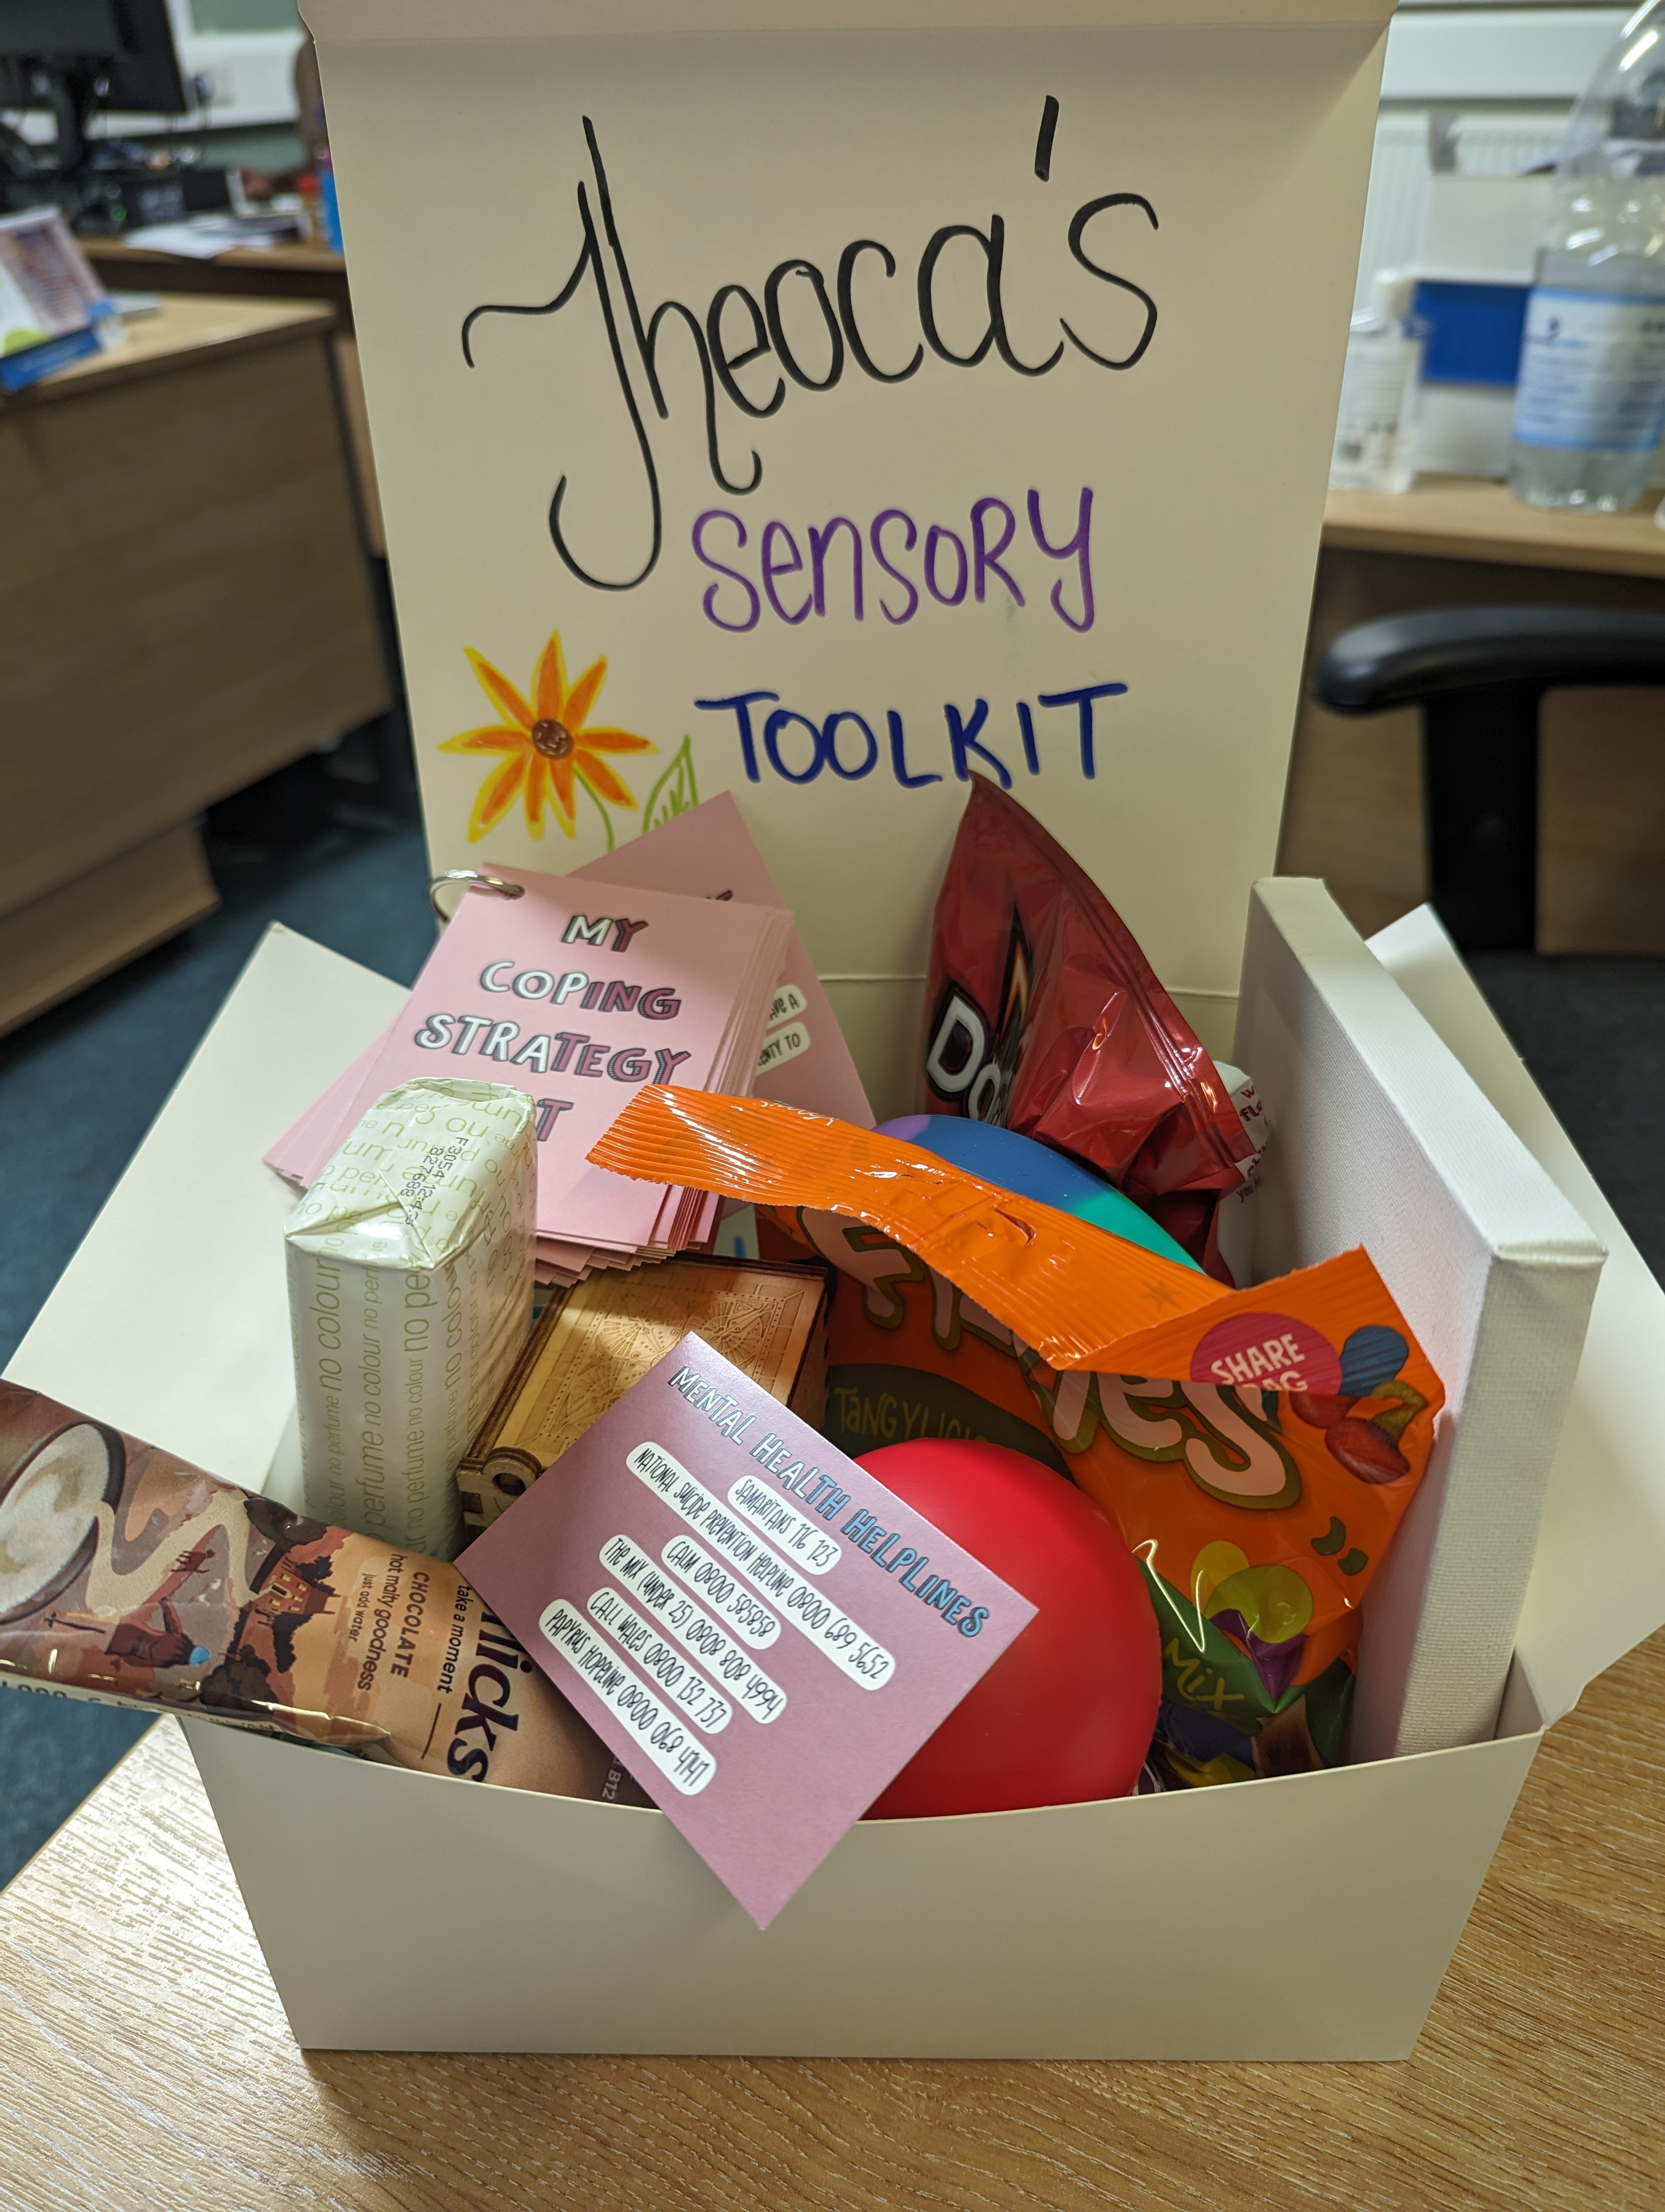
EXAMPLE OF A PERSONALISED SENSORY TOOLBOX

Slide 40
THE INTERVENTION PROCESS
OT’s will provide sensory interventions on a 1:1 or group basis
Sensory Modulation Toolkits will be created with the service user and issued to them
Feedback given to ward staff and updated on care plans
Some sensory modulation support will be given immediately (such as earplugs, headphones, radios etc.)
Specific interventions that have specific needs (such as use of weighted blanket) will have a set of instructions on how this can be facilitated with the service user
Ward staff can use the sensory de-escalation box on the ward or feedback to OT to provide resources in line with need
Notes:
OT’s will provide sensory interventions on a 1:1 or group basis- depending on their level of recovery and engagement ability
Toolkits will be created with the service user and issued to them- feedback given to ward staff and updated on care plans as reasonable adjustments where needed
Simple sensory modulation support will be given immediately (such as earplugs, headphones, radios etc.)
Specific interventions that have specific needs (such as use of weighted blanket) will have a set pf specific instructions on how this can be facilitated with the service user

Slide 41
LETS UNPACK A DE-ESCALATION SENSORY BOX TOGETHER
Notes:
LOOK AT THE

Slide 42
EXAMPLES OF WHAT YOU WOULD FIND IN A SENSORY DE-ESCALATION BOX ON THE WARD
Teddy bear/ squishies
Fidget toys
Art and craft activities for distraction
Hot chocolate, warm drinks
Ice pack- immediate freeze
Stress balls and squishy materials, hand putty, kinetic sand
Music; radio, earphones, earplugs
Sour sweets, wine gums
Grounding technique cards
Notes:
Can put picture of ward sensory box here instead (I didn’t have the time to update and take a pic)
Vibration pillow/seat (used with supervision),weighted blanket with OT

Slide 43
OTHER WAYS YOU CAN HELP?
USE the sensory box in 121 sessions to facilitate exploration, likes and dislikes
OBSERVE patients on the ward
REFER to occupational therapy for assessment when needed- or ask for resources
ASK patients how they feel, what do they need, how can we support
ENCOURAGE the use of the sensory toolkit that the service user has created when in distress
ASSIST with sensory safety plan by giving your feedback

Slide 44
So the next time you are observing a patient; perhaps we can ask; Is the behaviour I am observing trying to meet a sensory need?
(O’Sullivan & Fitzgibbon, 2023)

Slide 45
FEEDBACK/QUESTIONS?

Slide 46
References
O’Sullivan, J. & Fitzgibbon, C.(2018). Sensory Modulation: Resource manual. Amazon digital services. EBook: Amazon
Online Training:
SensoryModulationBNE
sensory-modulation-Brisbane.com
Contacts: sensorymoded@gmail.com
O’Sullivan, J. & Fitzgibbon, C.(2023). Sensory Modulation Brisbane; using a sensory lens with clients [Webinars 1-3]. Online: https://sensory-modulation-brisbane.com/training-options
Images
Image sourced from Dizzy Doctor (2024). Available at: https://dizzydoctor.blog/2017/11/13/you-have-a-different-approach/
Image sourced from CBT4Panic (2024). Available at: https://cbt4panic.org/the-panic-cycle/
Image sourced from ConseilSante (2024). Available at: https://conseilsante.cliniquecmi.com/en/proprioception-exercices-in-physiotherapy/
Image created from Sensory ladders. Org(2024) Available at: https://sensoryproject.org/sensoryladders/
Sensory Image: Udemy (2023) Available at: https://www.udemy.com/course/sensory-processing-and-the-classroom/
Car Image: Dreamstime (2024). Available at: https://www.dreamstime.com/illustration/driving-car.html

Slide 47
Thank you

